Slide 1
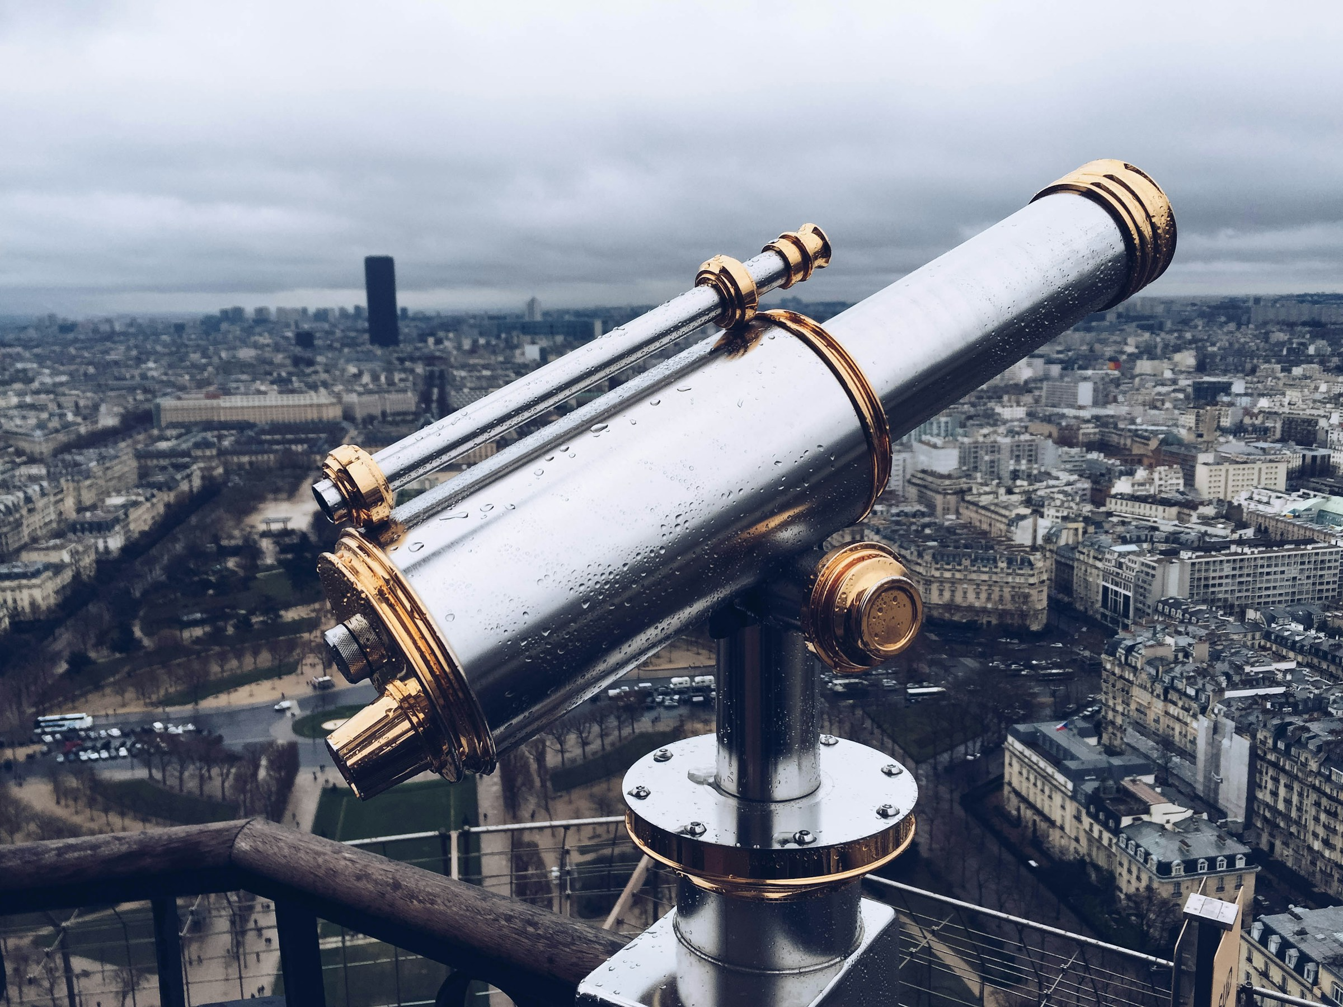
Explainable Search and Discovery of Visual Cultural Heritage Collections with Multimodal Large Language Models
Taylor ARNOLD + Lauren TILTON
Computational Humanities Research, 2024
Aarhus Universitet, Building 1324, Room 025
Aarhus, Danmark
5 December 2024, 15h30 > 17h00
https://distantviewing.org

Slide 2
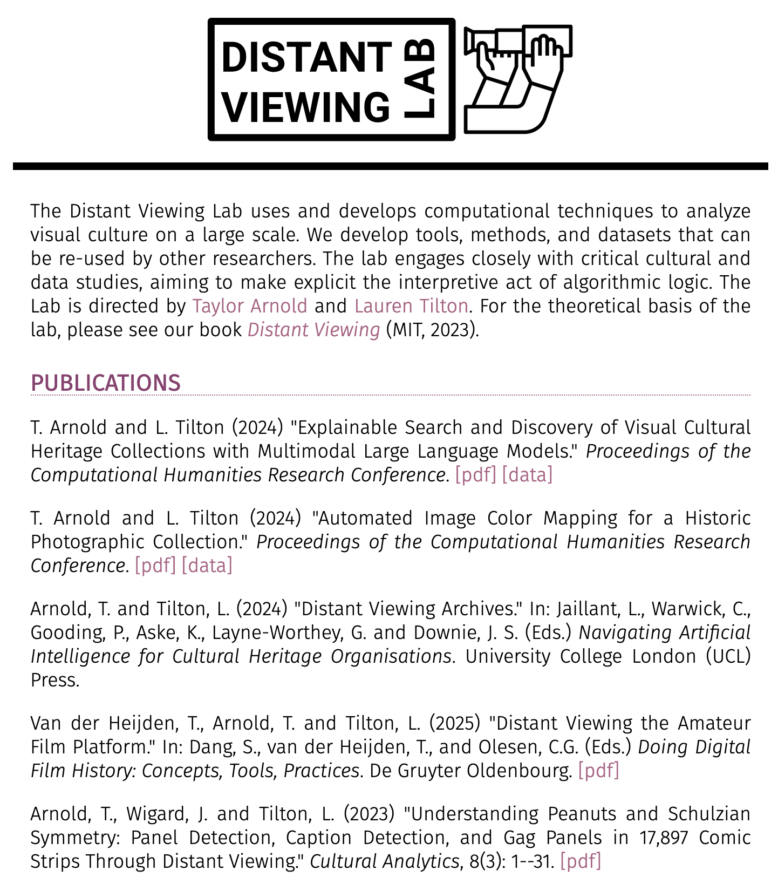


Distant Viewing Lab
The Distant Viewing Lab uses and develops computational techniques to analyze visual culture on a large scale.
We develop tools, methods, and datasets that can be re-used by other researchers. The lab engages closely with critical cultural and data studies, aiming to make explicit the interpretive act of algorithmic logic.
https://distantviewing.org
Generously supported through funding from:
01 – Distant Viewing | Introduction

Slide 3
1. Introduction
01 – Distant Viewing | Introduction

Slide 4
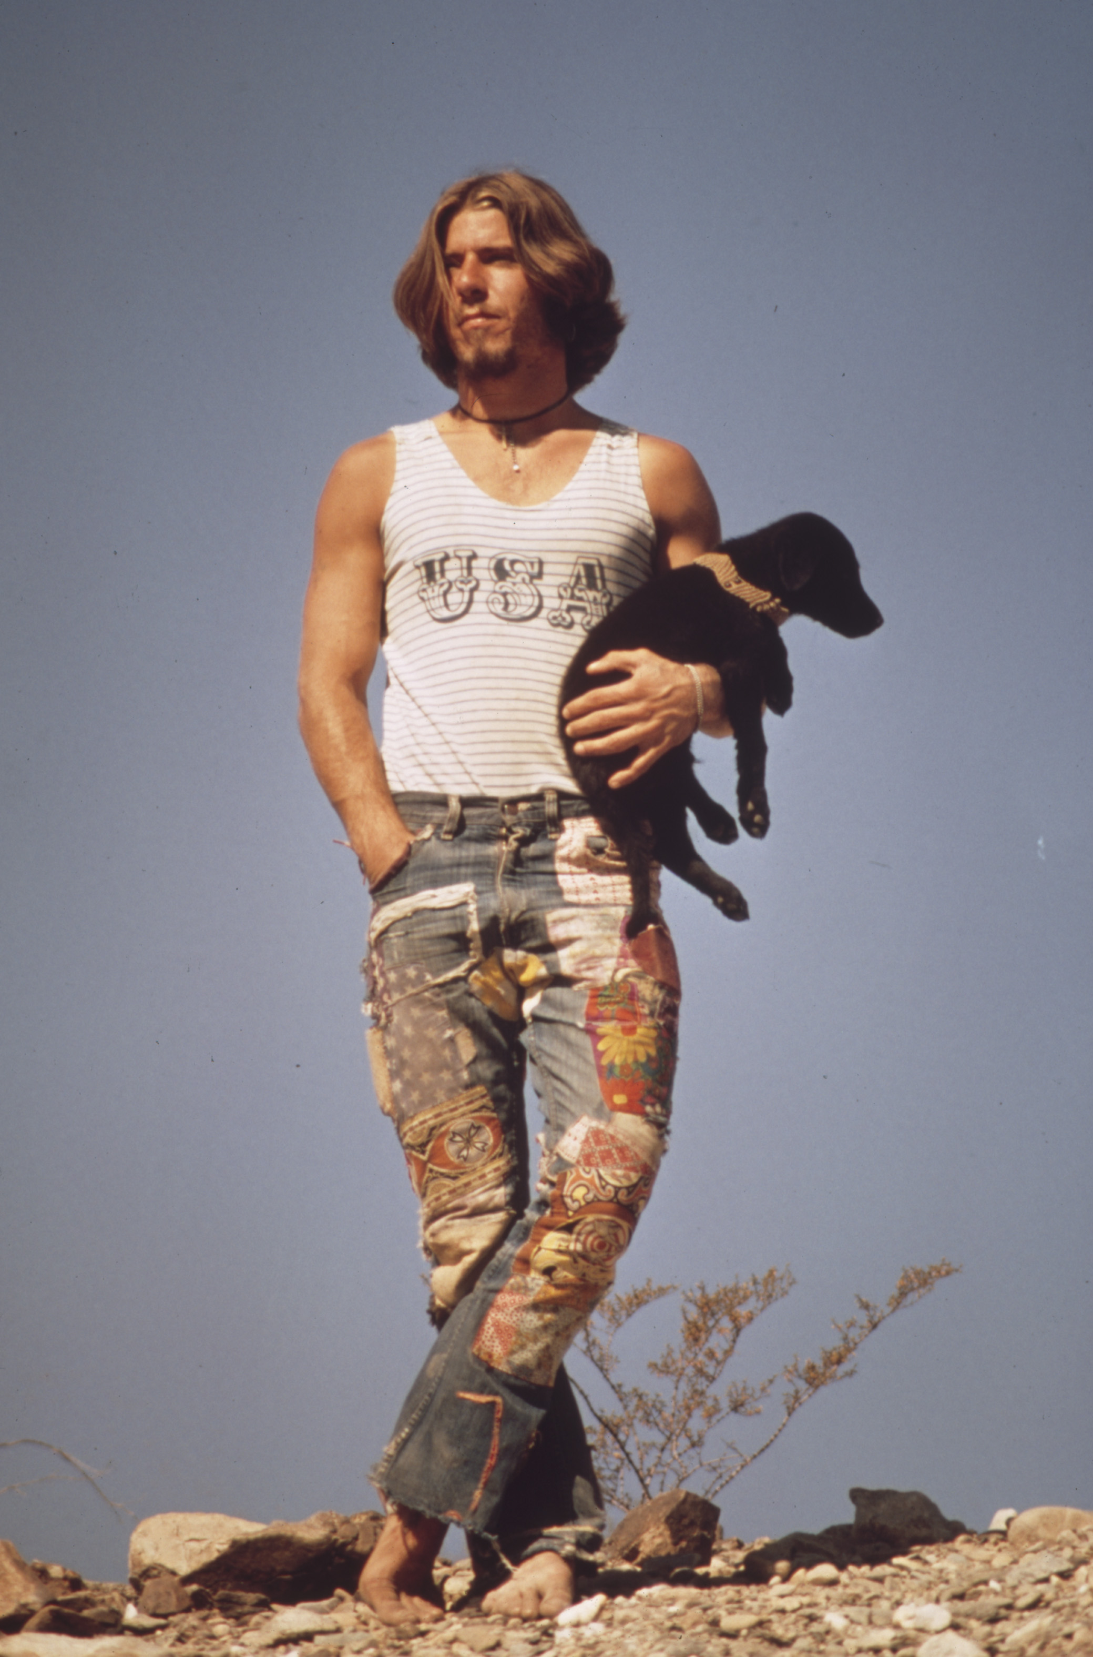
Outline
Introduce a historic photographic corpus from the 1970s.
Explore popular techniques for enabling search and discovery of photographic collections.
Present and evaluate a new method that uses large language models to improve capabilities of digital public interfaces.
See how this approach opens new possibilities for search and discovery of large photographic collections.
01 – Distant Viewing | Introduction
Charles O’Rear, Hitchhiker with His Dog, Tripper, On U.S. 66 (May 1972)

Slide 5
2. DOCUMERICA
02 – Distant Viewing | DOCUMERICA

Slide 6
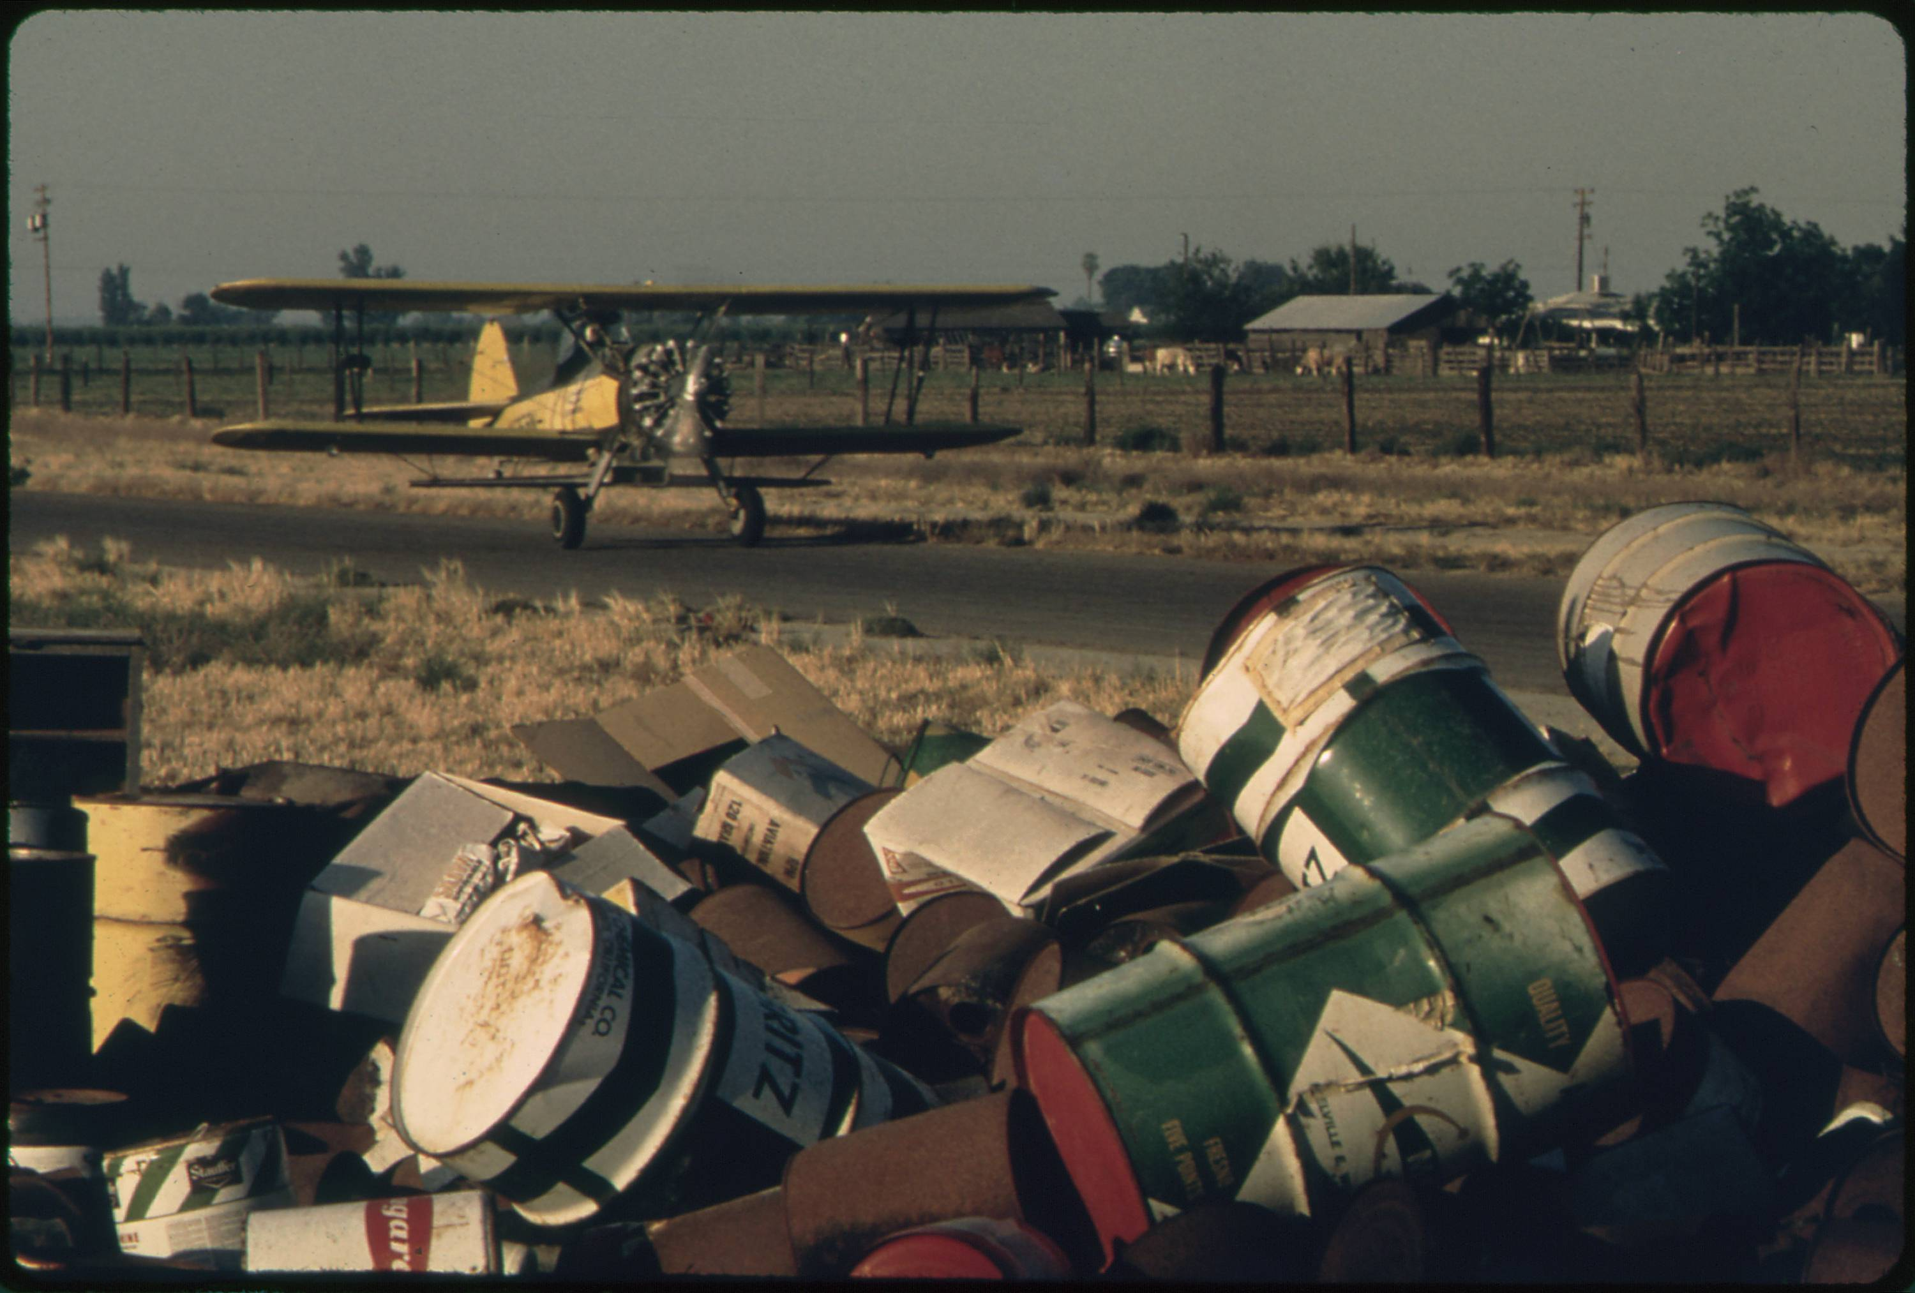
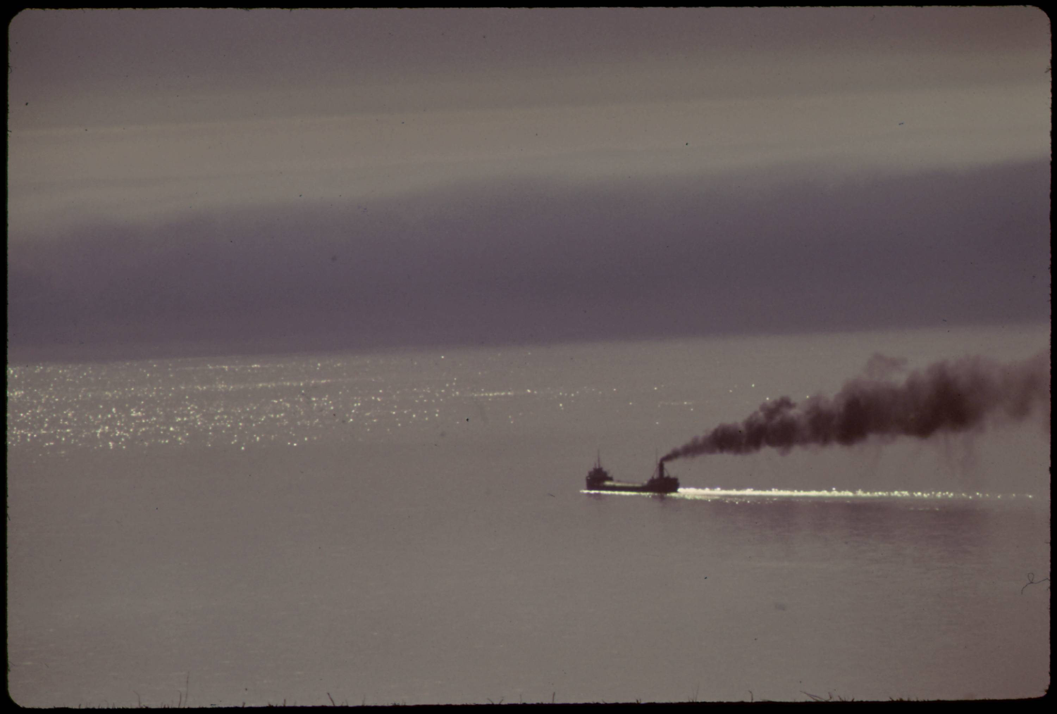
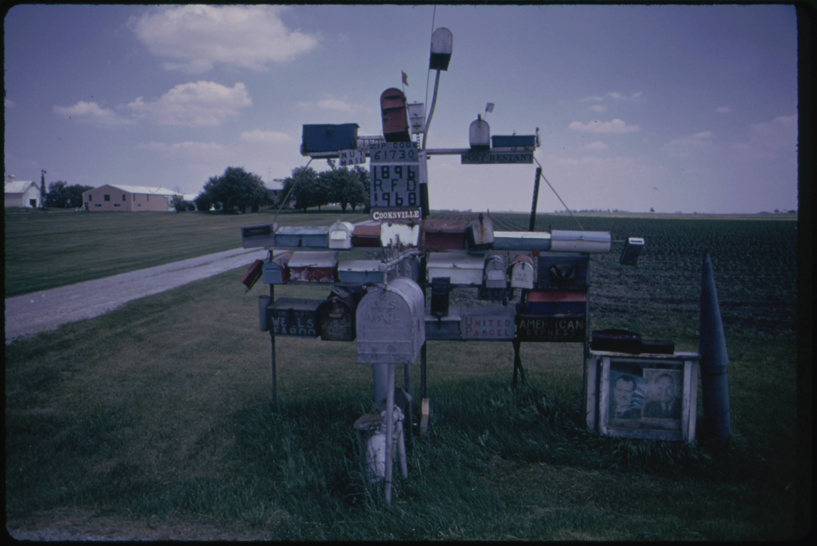
DOCUMERICA
From 1972 and 1978 the U.S. Environmental Protection Agency (EPA) sponsored the DOCUMERIC project to document contemporary environment issues and highlight ongoing work by the agency.
Gene Daniels, Discarded Pesticide Cans (May 1972).
Donald Emmerich, Ore Carrier Heads into Lake Superior (June 1973).
Arthur Greenberg, Excentric Mailbox Display (June 1973).
02 – Distant Viewing | DOCUMERICA

Slide 7
DOCUMERICA
From 1972 and 1978 the U.S. Environmental Protection Agency (EPA) sponsored the DOCUMERIC project to document contemporary environment issues and highlight ongoing work by the agency.
The U.S. National Archies and Records Administration (NARA) has digitized and made available nearly 16,000 images taken by the DOCUMERICA photographers.
Gene Daniels, Discarded Pesticide Cans (May 1972).
Donald Emmerich, Ore Carrier Heads into Lake Superior (June 1973).
Arthur Greenberg, Excentric Mailbox Display (June 1973).
02 – Distant Viewing | DOCUMERICA

Slide 8
DOCUMERICA
From 1972 and 1978 the U.S. Environmental Protection Agency (EPA) sponsored the DOCUMERIC project to document contemporary environment issues and highlight ongoing work by the agency.
The U.S. National Archies and Records Administration (NARA) has digitized and made available nearly 16,000 images taken by the DOCUMERICA photographers.
Public interest in the collection has recently grown with the increased focus on environmental concerns. While the images are freely accessible from the NARA website and released into the public domain, the ability to understand the scope of the collection in its current form is limited.
Gene Daniels, Discarded Pesticide Cans (May 1972).
Donald Emmerich, Ore Carrier Heads into Lake Superior (June 1973).
Arthur Greenberg, Excentric Mailbox Display (June 1973).
02 – Distant Viewing | DOCUMERICA

Slide 9
DOCUMERICA
Gene Daniels, Discarded Pesticide Cans (May 1972).
The research question that drives our work today:
How can we use computational approaches to help organize and create generous interfaces for this important photographic archive?
Donald Emmerich, Ore Carrier Heads into Lake Superior (June 1973).
Arthur Greenberg, Excentric Mailbox Display (June 1973).
02 – Distant Viewing | DOCUMERICA

Slide 10
3. Three "Classic" Approaches
03 – Distant Viewing | Classic Approaches

Slide 11
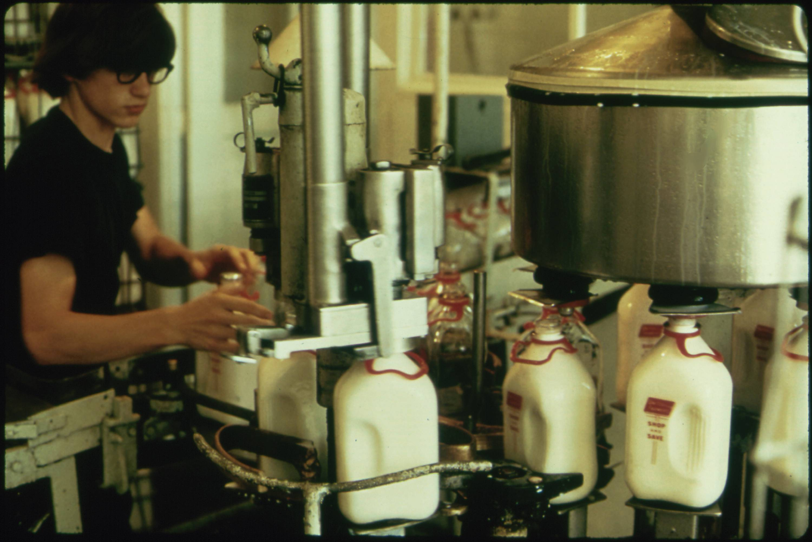
Approach 1: Use the Metadata
One possibility is to built a public interface around existing metadata. This can be a powerful technique, particularly when rich metadata is already available and aligns well with the kinds of exploration and discovery that users of the collection are interested in.
The DOCUMERICA corpus includes some limited but fairly consist metadata, but most photos do include a location (at the level of a town), date (month and year), and the name of the photographer. Most images have captions; some of these are several sentences, whereas many only include a few key terms.
July 1974
Flip Schulke
New Ulm, Minnesota
03 – Distant Viewing | Classic Approaches

Slide 12
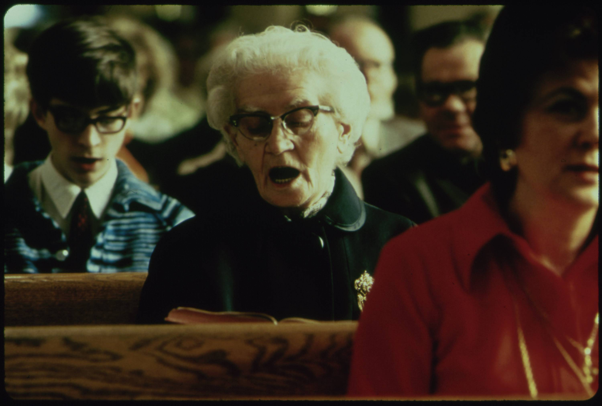
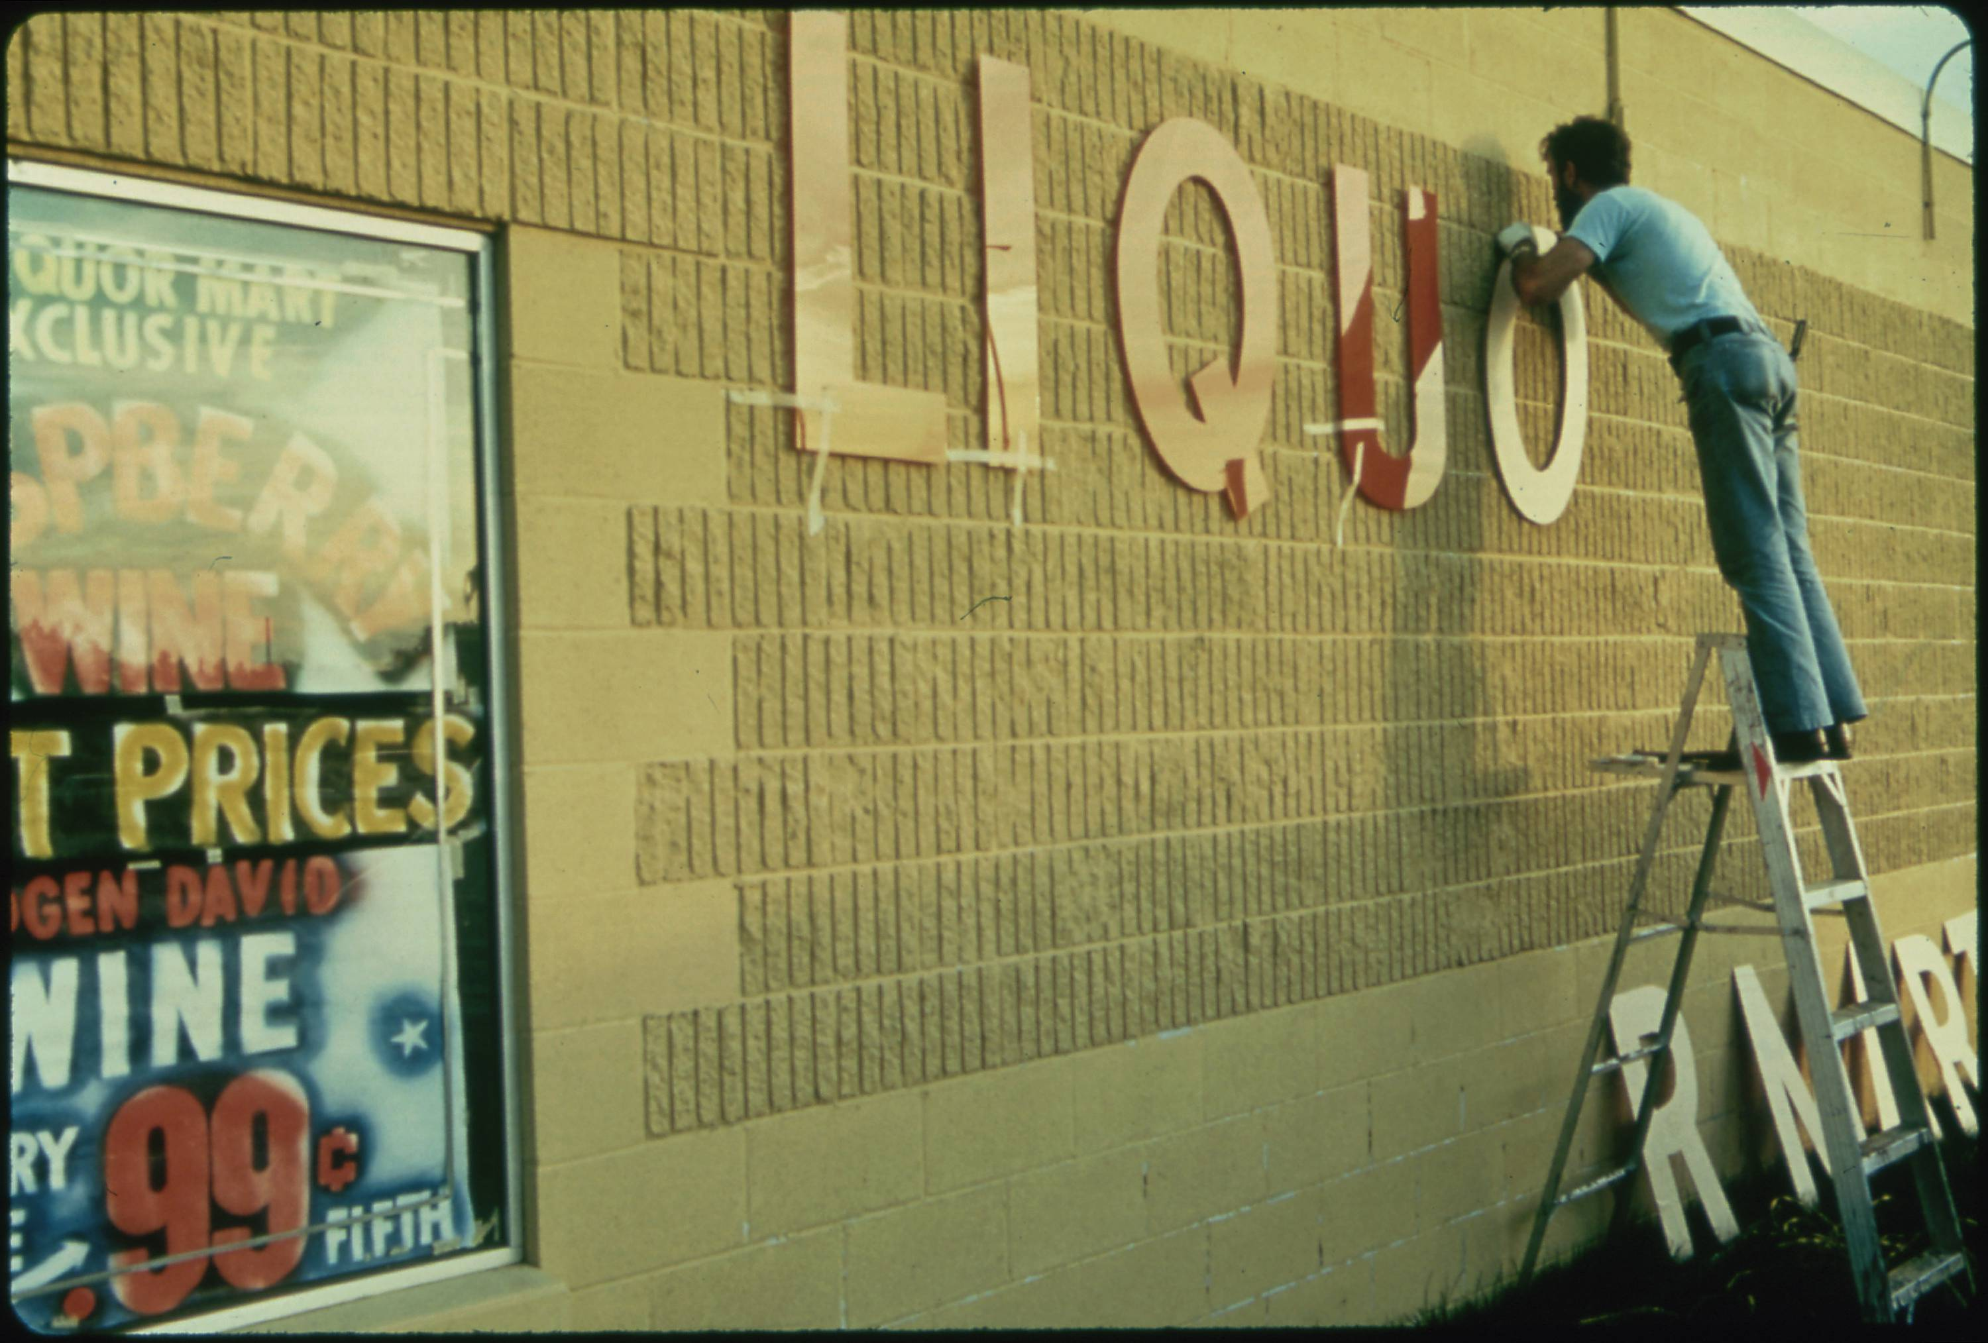
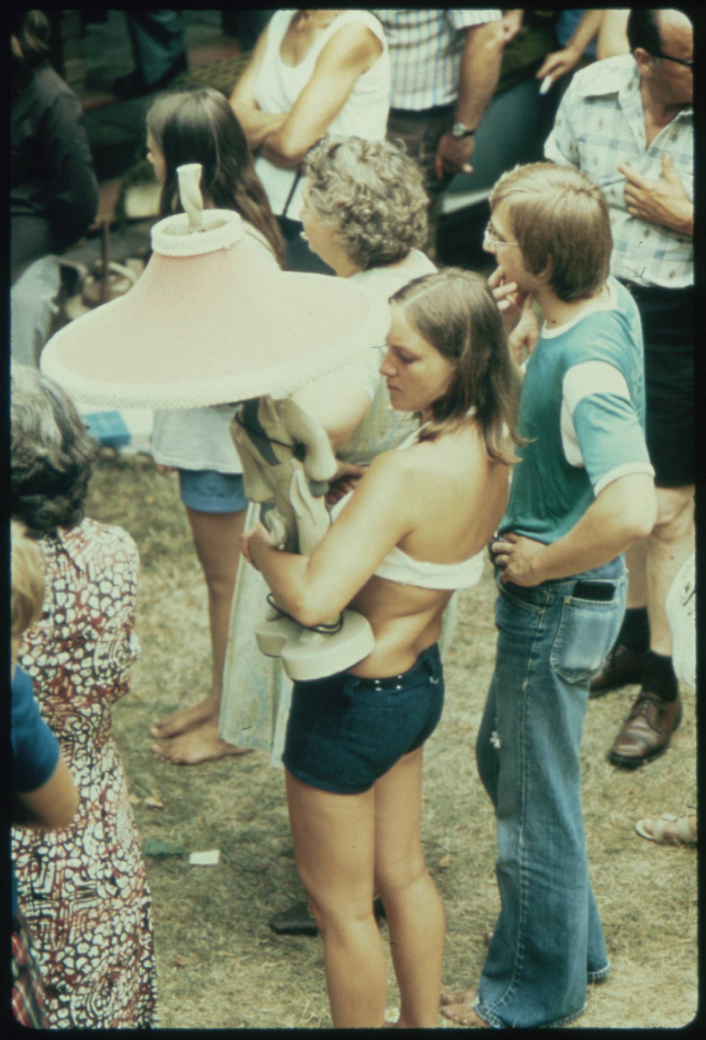
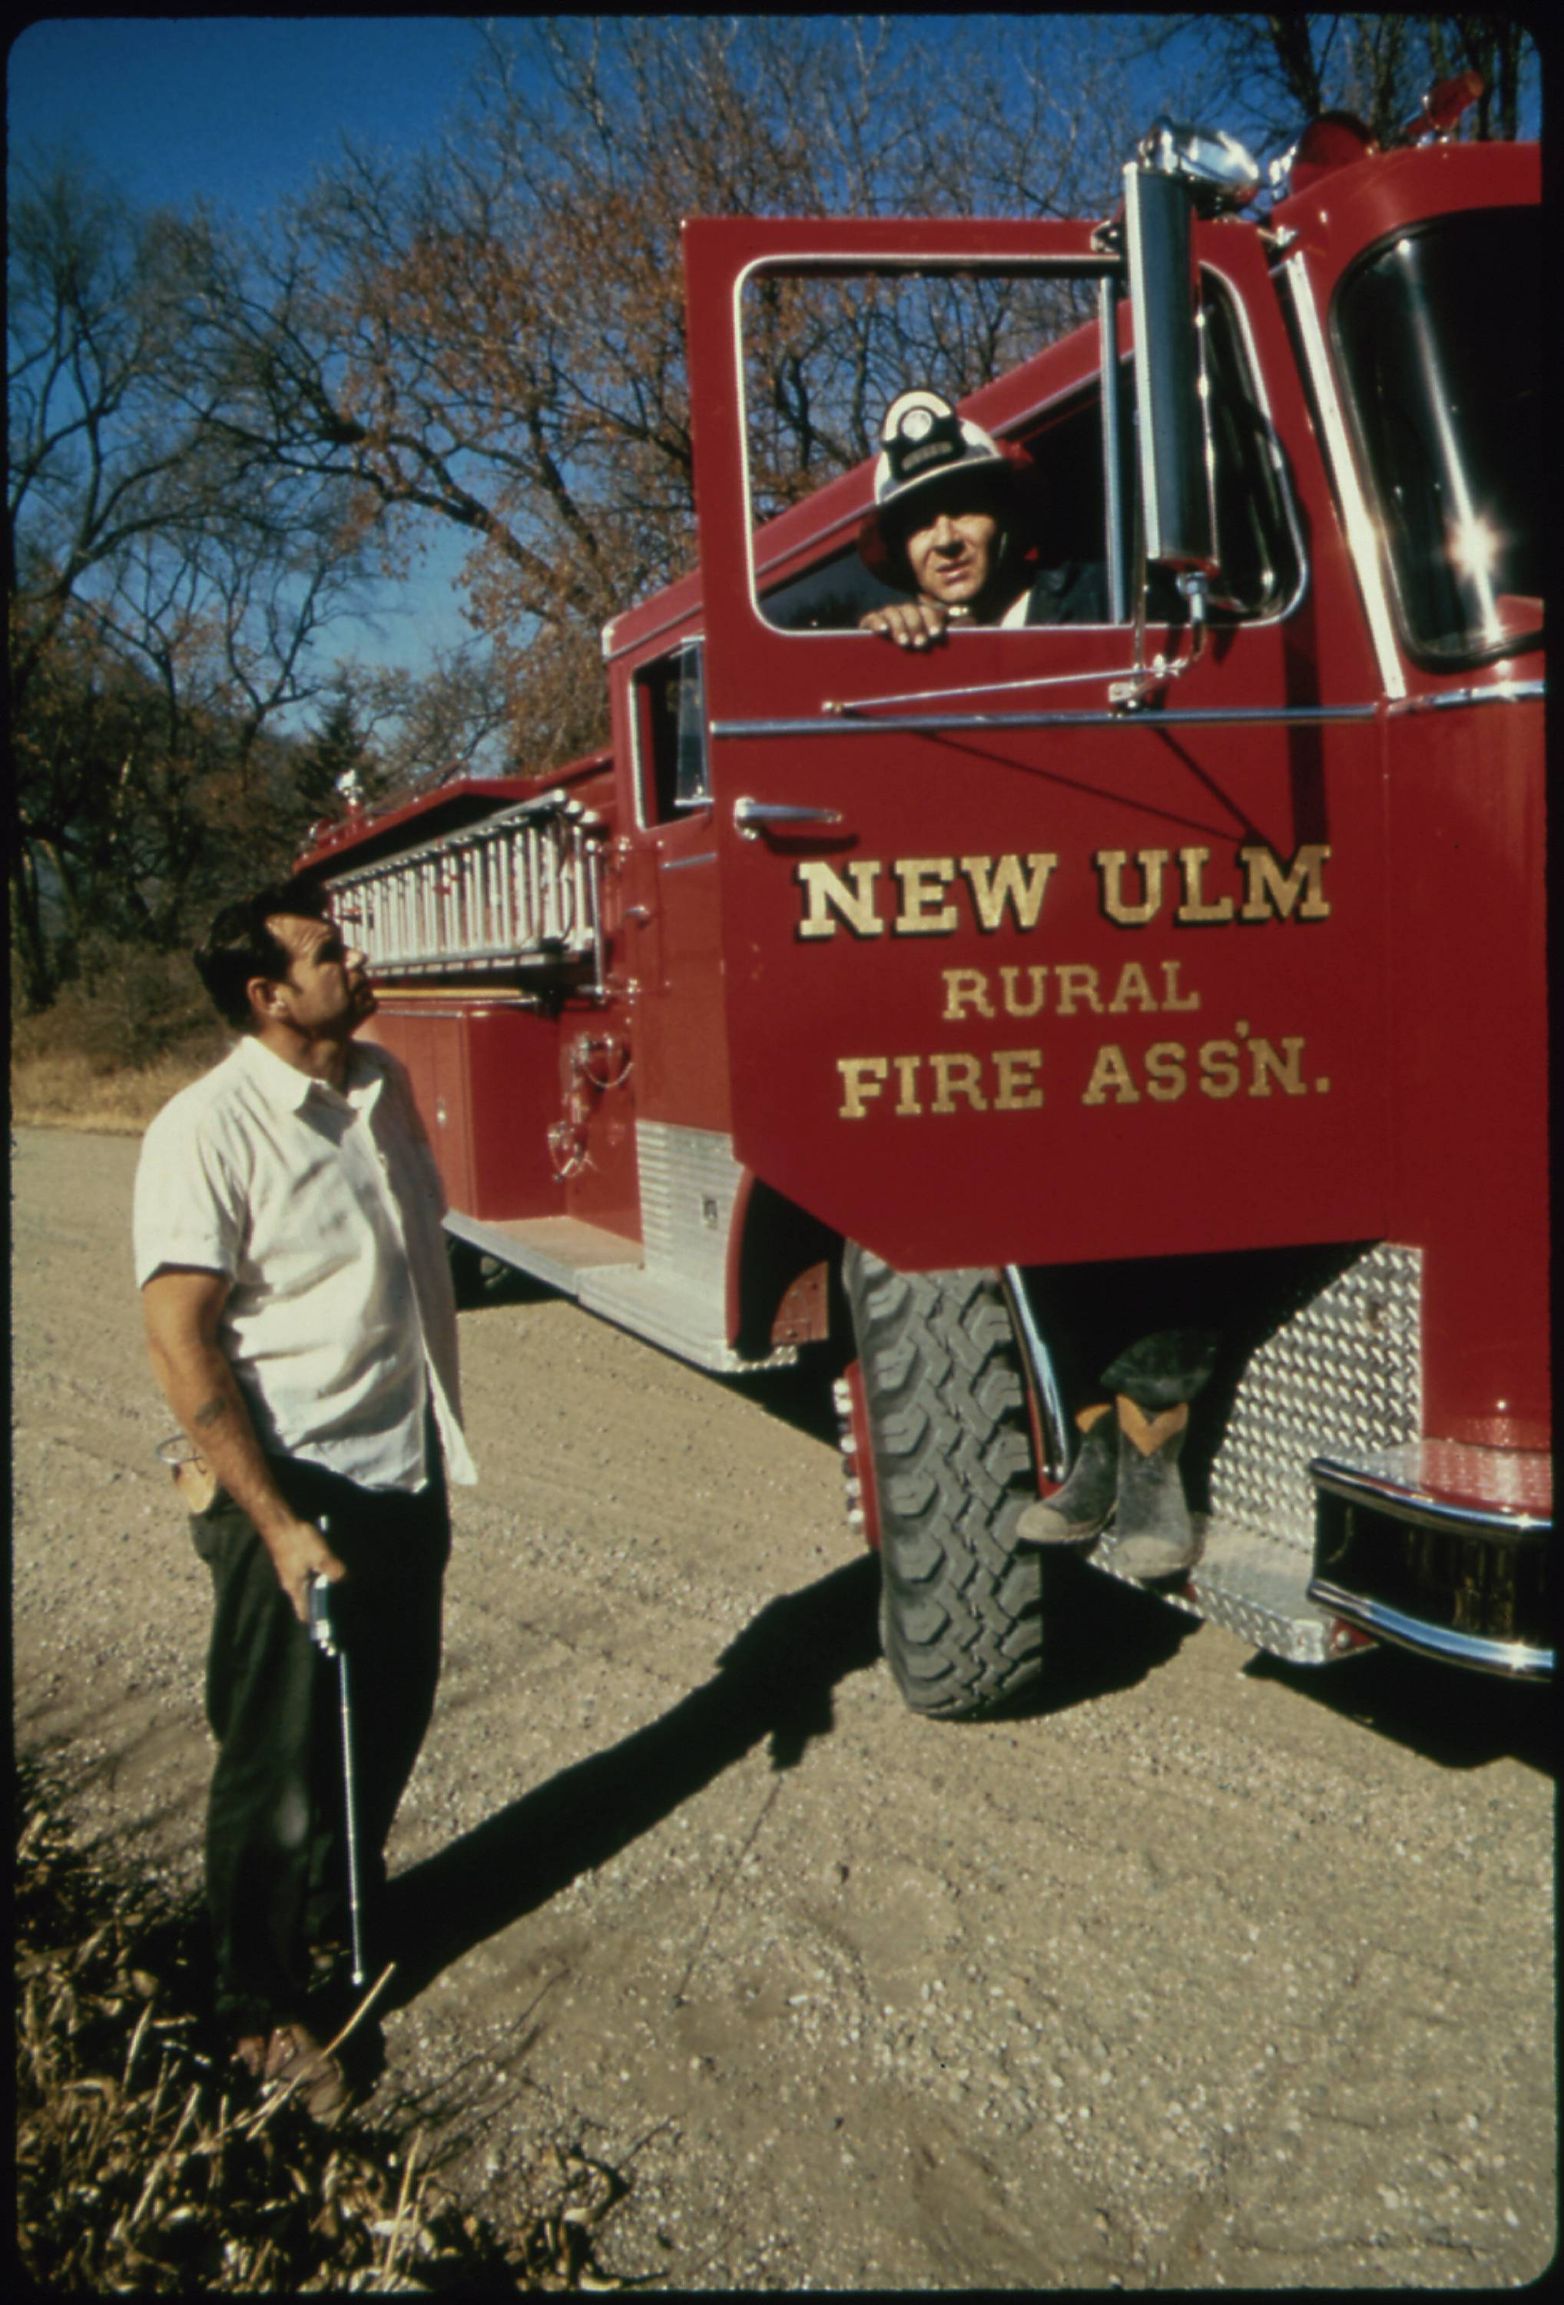
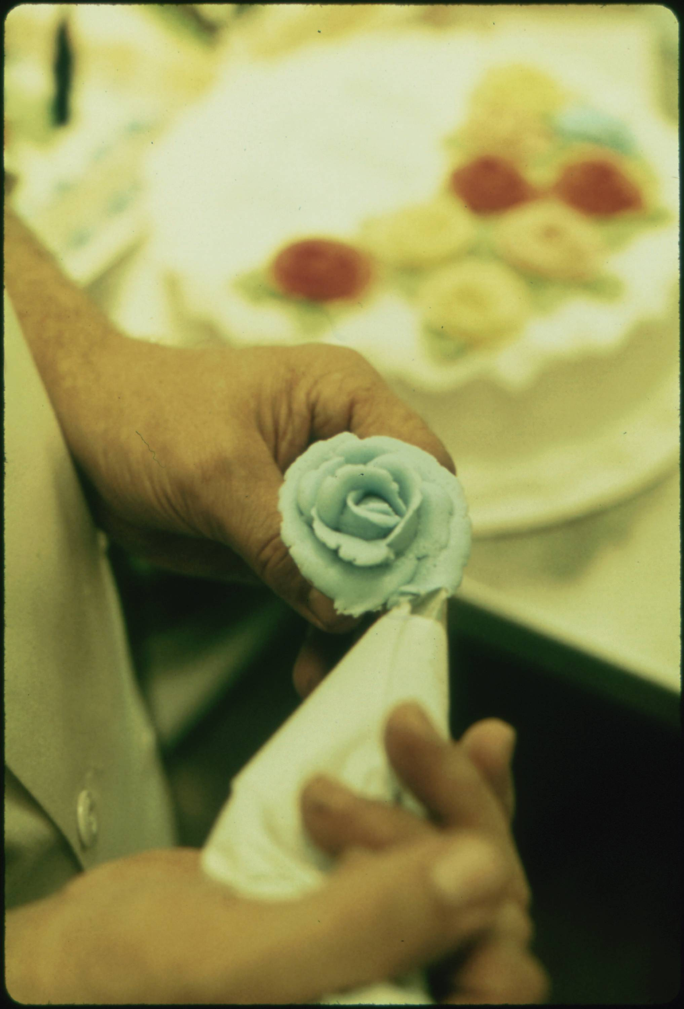
Approach 1: Use the Metadata
For example, here are the other images that have the same photographer, location, and date as our starting image. It seems that Flip Schulke took a variety of images throughout the town of Ulm, Minnesota during his visit in July 1074.
Flip Schulke, Five Photos from Ulm, Minnesota, Documerica Project (July 1974).
03 – Distant Viewing | Classic Approaches

Slide 13
Approach 1: Use the Metadata
Advantages
Relatively easy to integrate into a public interface.
Simple to explain, understand, and regulate.
Can be used with nearly any kind of archive.
Avoids some potential difficulties that government archives have with creating/displaying original information.
Difficulties
Can only be used with collections that have rich metadata.
Locked into the archival logic of the collection.
Metadata may be too granular or too coarse for specific applications.
Does not use the visual component of the images in a direct way.
Flip Schulke, Five Photos from Ulm, Minnesota, Documerica Project (July 1974).
03 – Distant Viewing | Classic Approaches

Slide 14
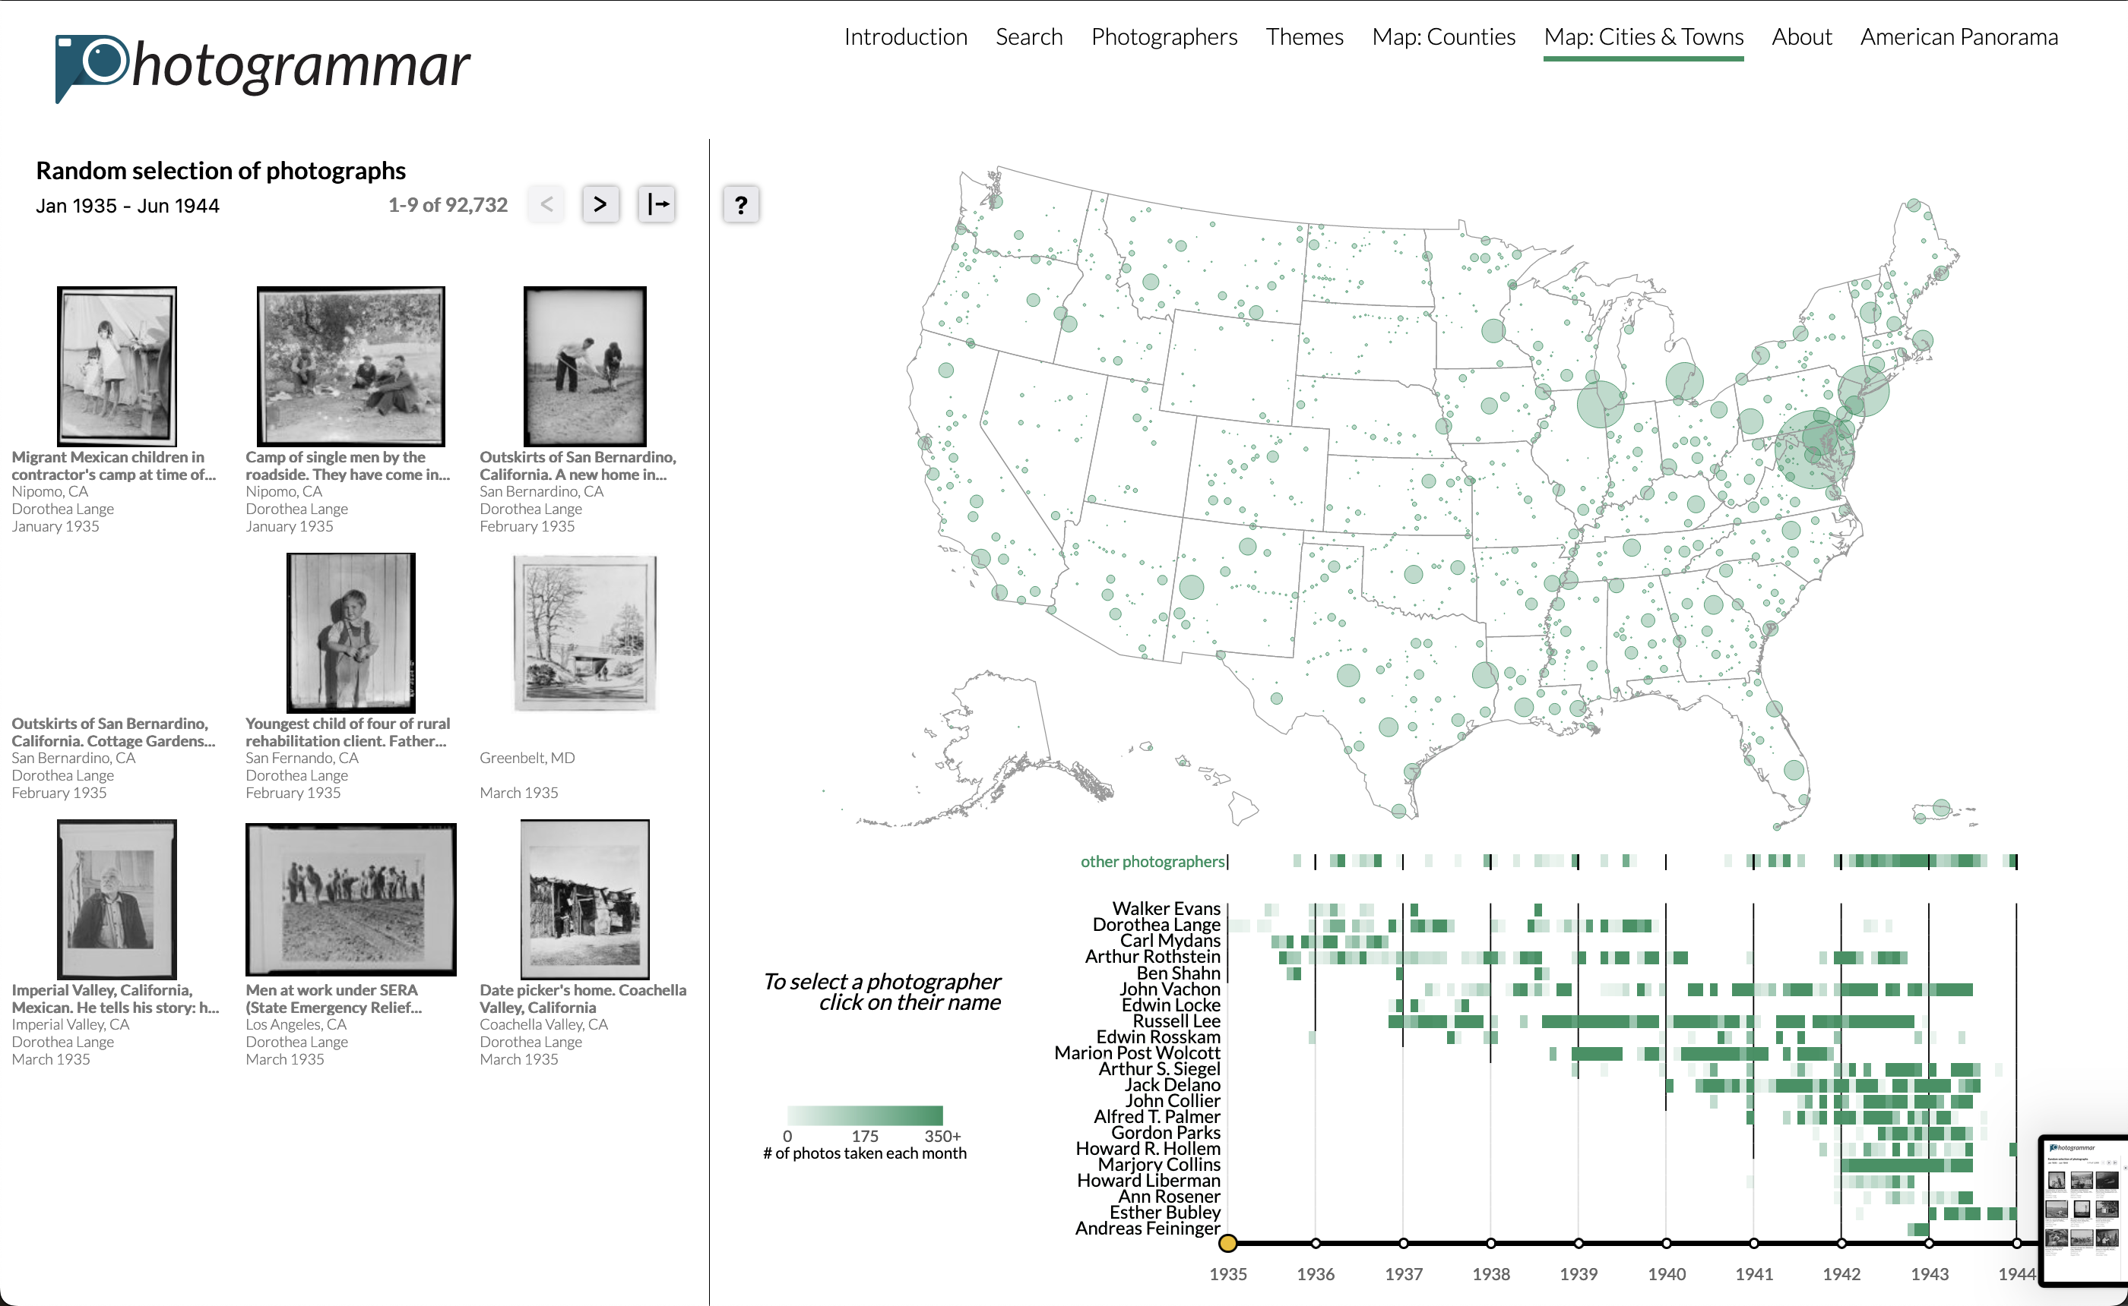
Approach 1: Use the Metadata
Until the past decade, using metadata to organize a collection was more-or-less the only general approach.
The first and second iterations of our public project Photogrammar to visualize the over 170k photographs of the FSA-OWI were all created with metadata as the only organizational logic.
We and others learned a lot about the collection through exploring the spatial, temporal, thematic, material, and other facets of metadata available in the collection.
https://photogrammar.org
T. Arnold, P. Leonard and L. Tilton. (2017) "Knowledge Creation Through Recommender Systems." Digital Scholarship in the Humanities, 32.3: 151-157.
03 – Distant Viewing | Classic Approaches

Slide 15
Approach 2: Supervised ML with Computer Vision
A second approach that have become increasingly possible is the application of computer vision algorithms to tag images with specific features using pre-built models.
For example, object detection can identify with a high degree of accuracy objects within the image of a photograph from a set of pre-defined categories. In our example image, one computer vision algorithm was able to detect the presence of at least one bottle in the frame.
The detected objects can be used just as with the archival metadata. This includes allowing for faceted search and creating recommendations that link one photo to other recommendations based on similar objects.
{ bottle }
03 – Distant Viewing | Classic Approaches

Slide 16
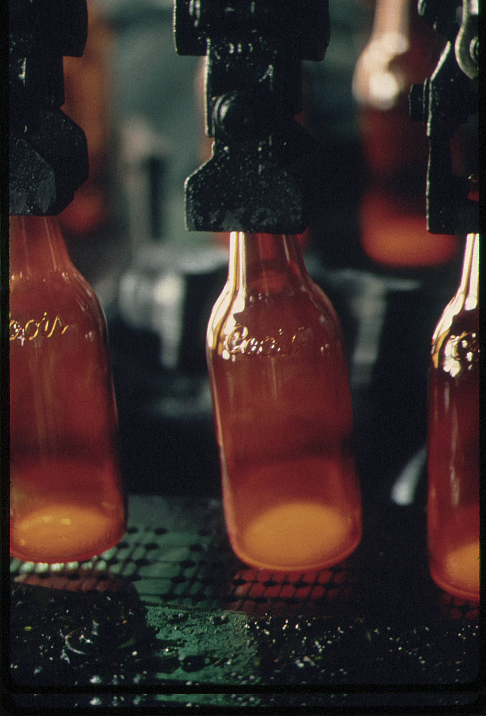
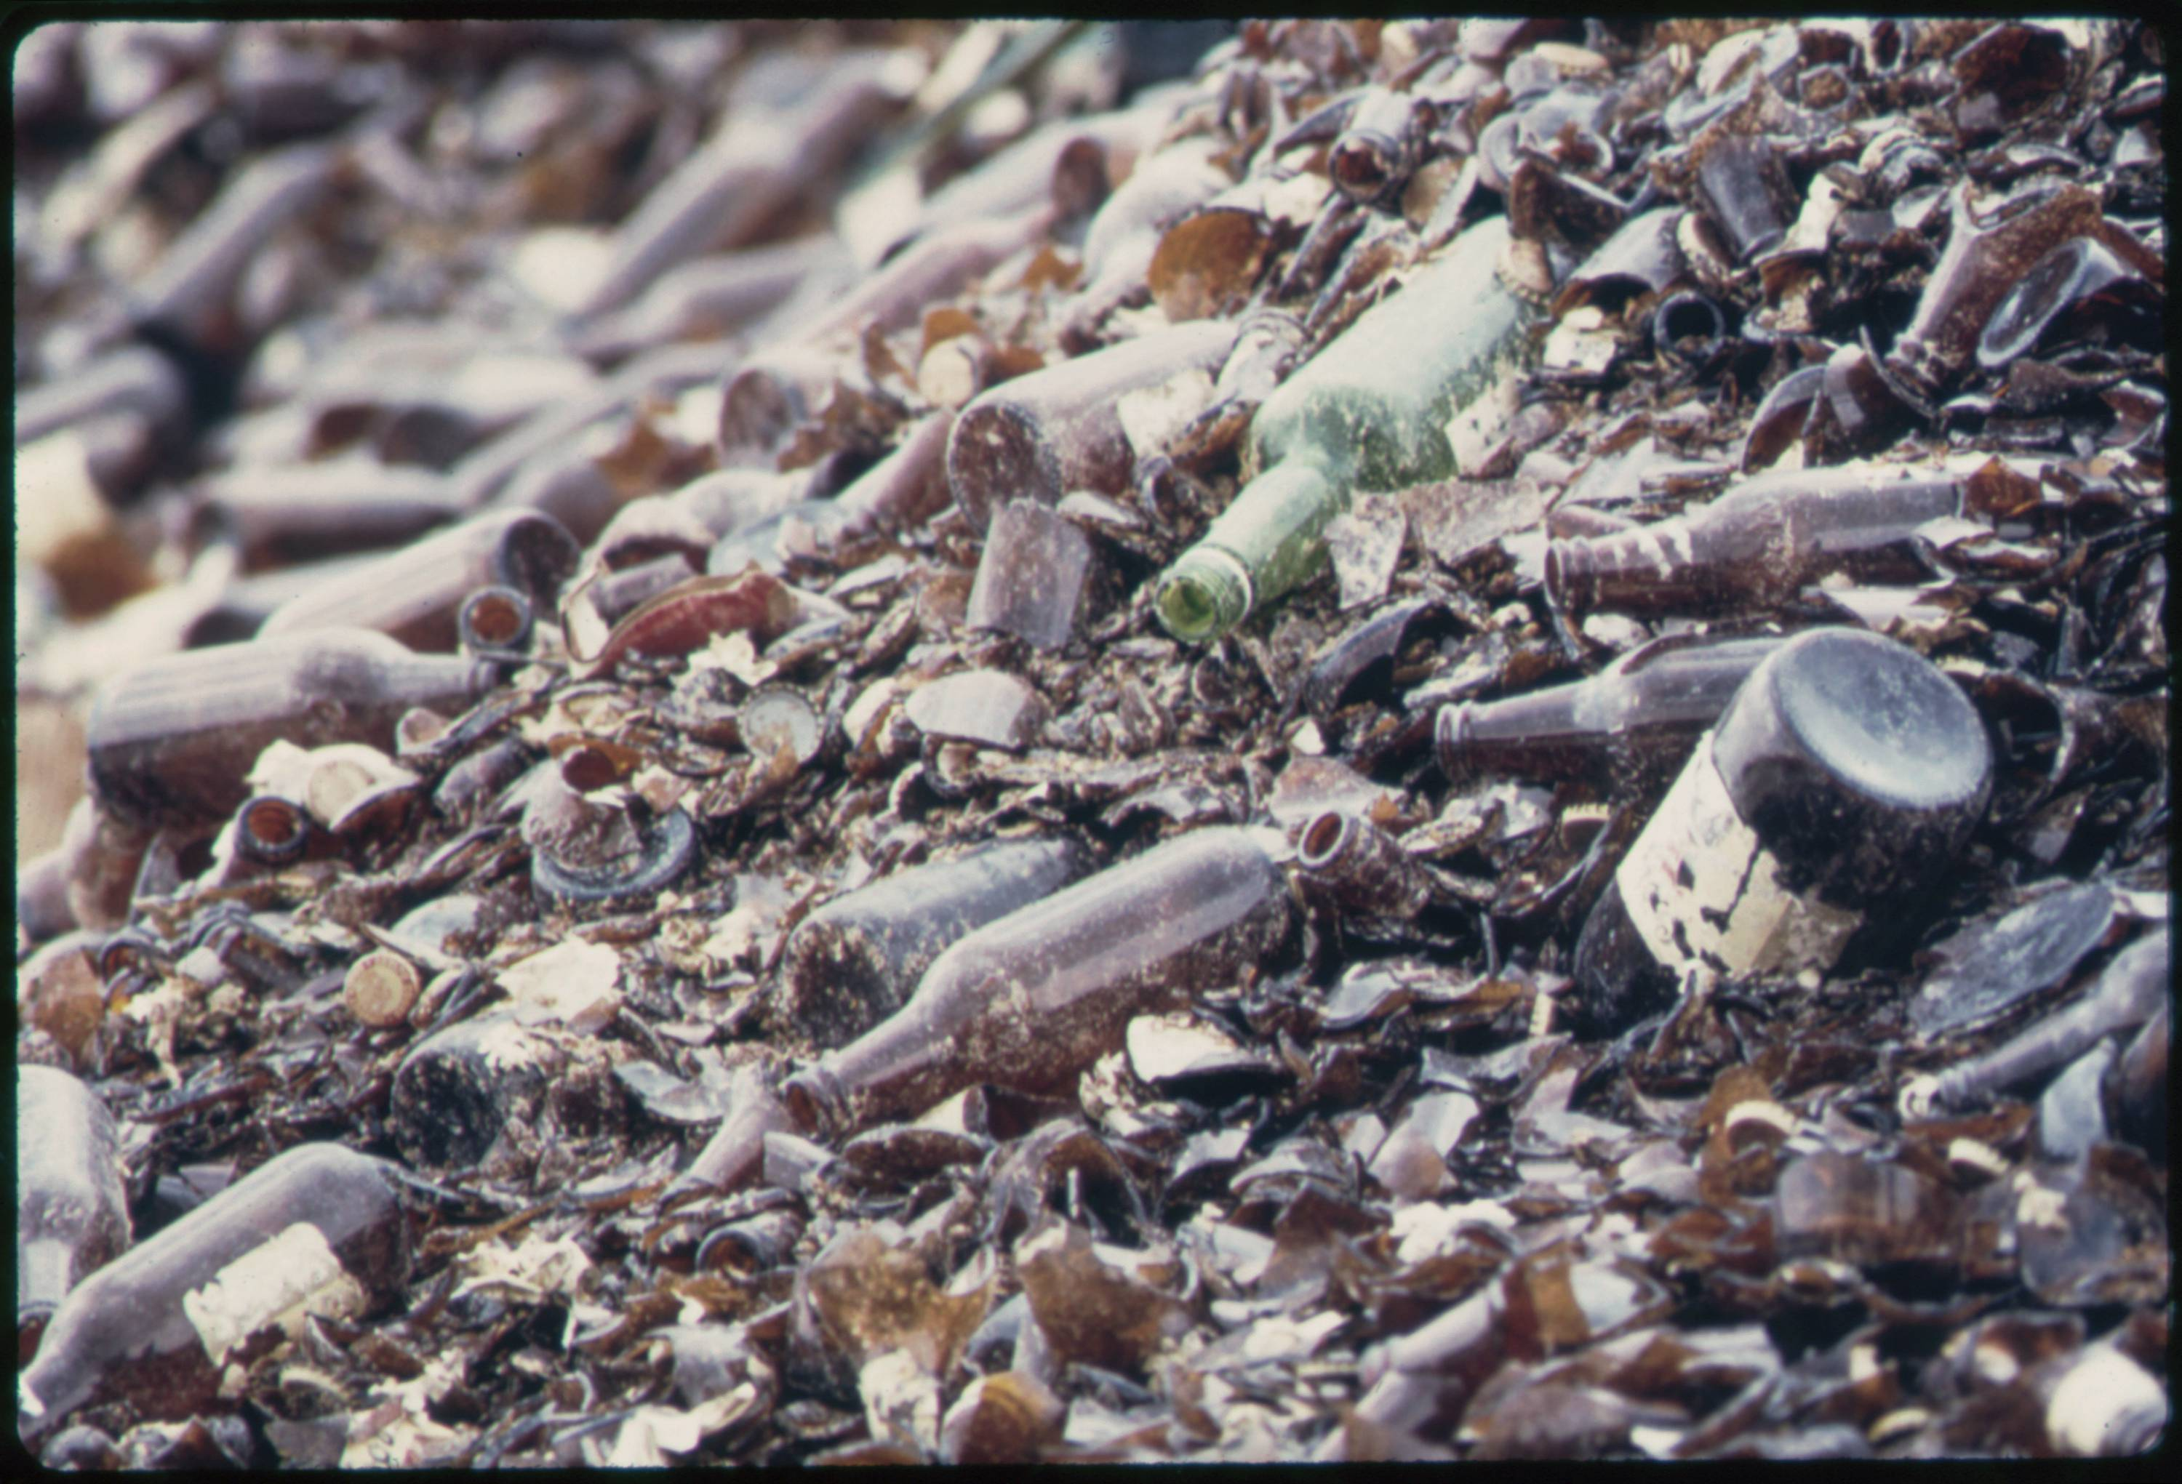
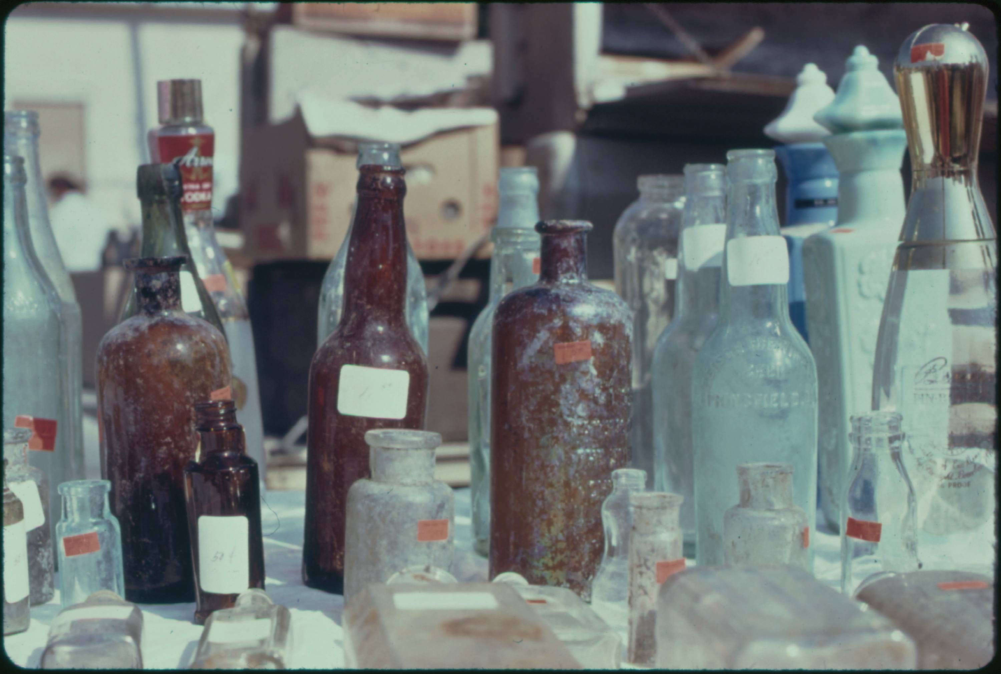
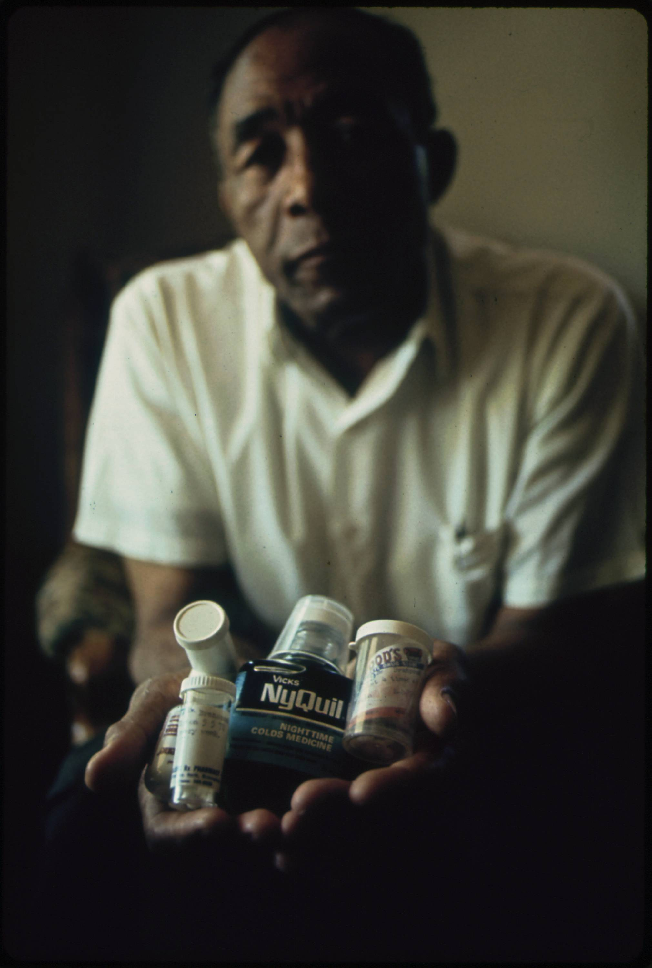
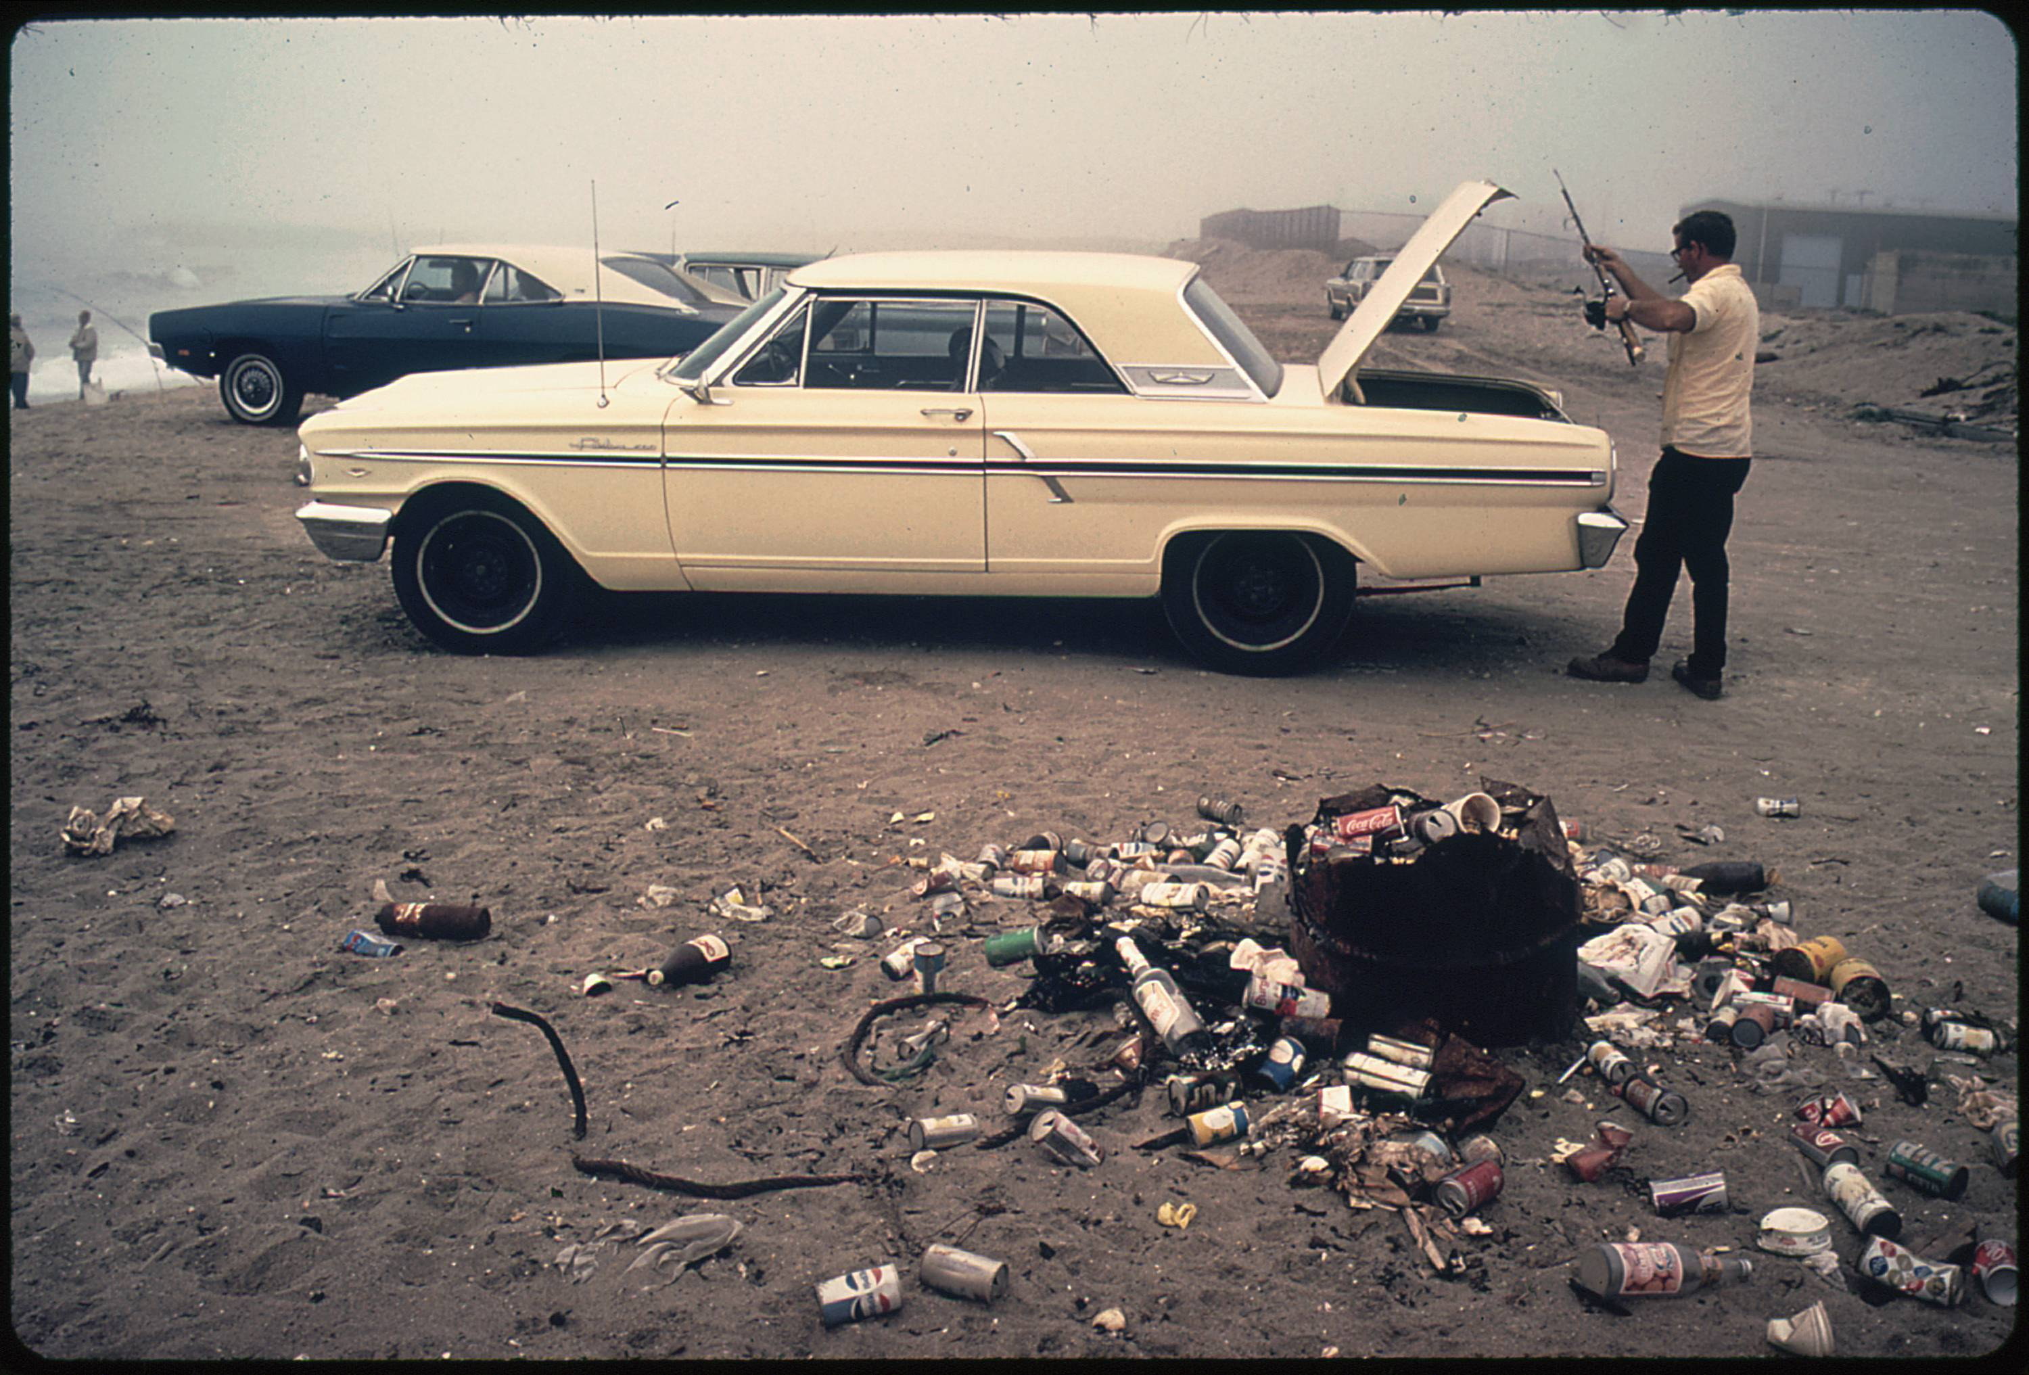
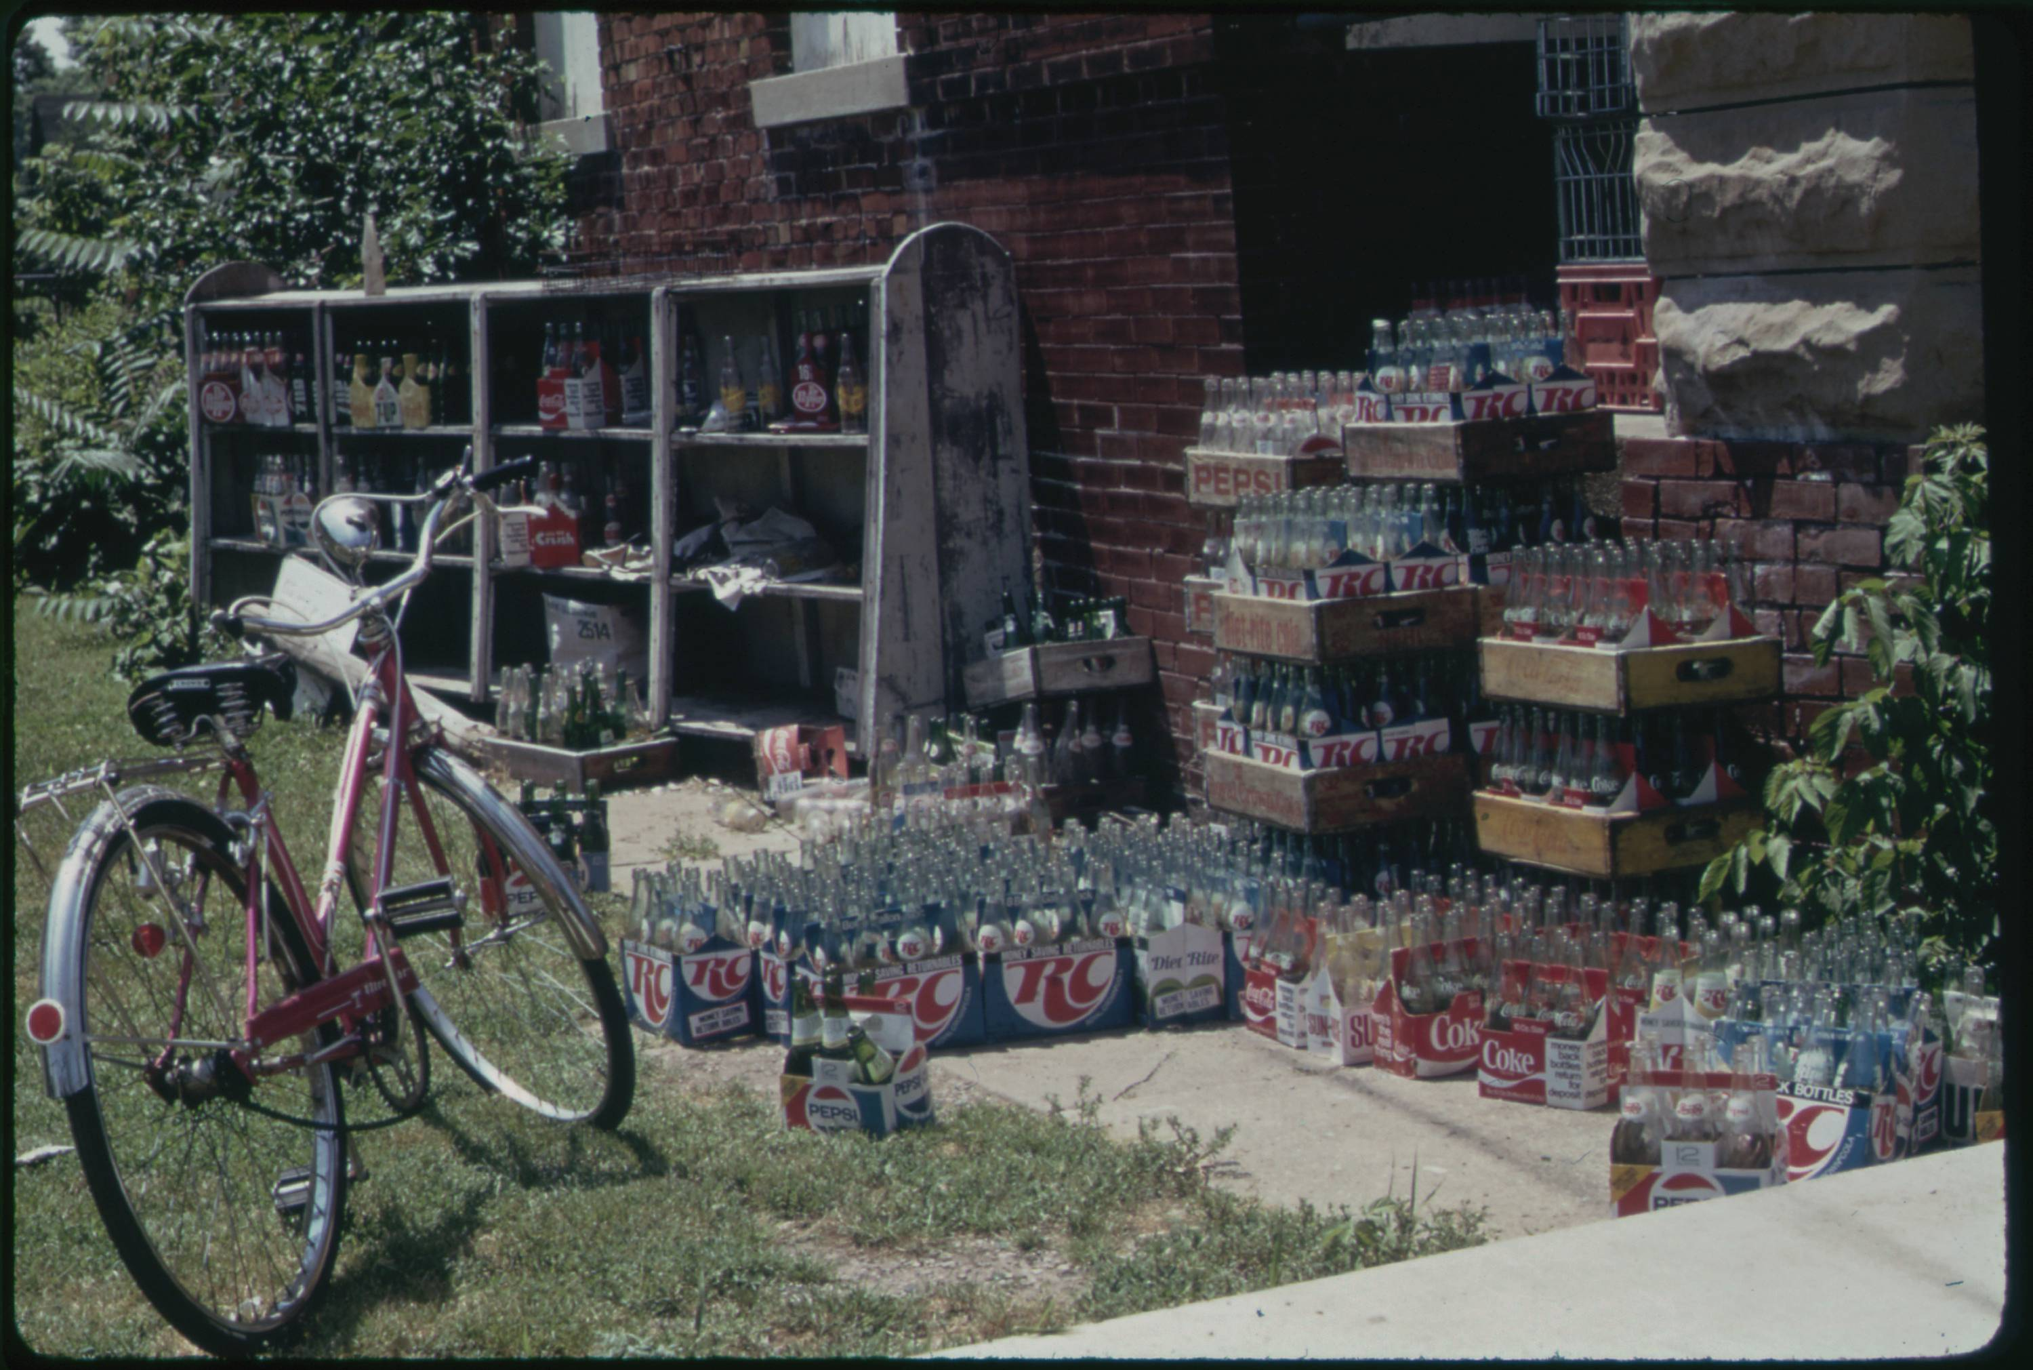
Approach 2: Supervised ML with Computer Vision
Using our example image, here are the six images in which our computer vision algorithm also detected bottles with a high probability.
Notice that this has found six interesting uses of bottles in different formats: a recycle plant, trash piles, medicine containers, and as another part of the supply chain being delivered to a store.
03 – Distant Viewing | Classic Approaches

Slide 17
Approach 2: Supervised ML with Computer Vision
Advantages
Can be applied to collections with no or limited archival metadata, regardless of size.
Allows integration new kinds of annotation that can cut across extant archival categories.
Difficulties
Most models out-of-the-box are trained on photographs and do not work well on other inputs.
Need to explain and contextualize the created labels, which may contain errors or produce problematic connections.
Existing tags do not usually align with the interesting connections within an archive.
Creating new models can be difficult and time intensive.
For end-users, the outputs are as (if not more) restrictive that metadata categories.
03 – Distant Viewing | Classic Approaches

Slide 18


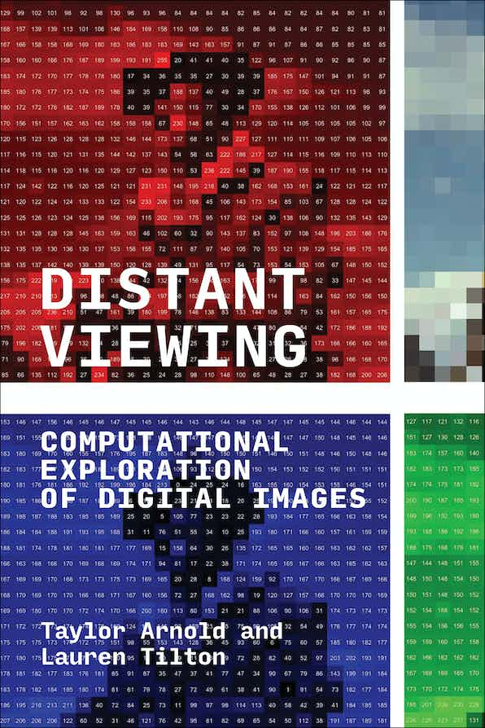
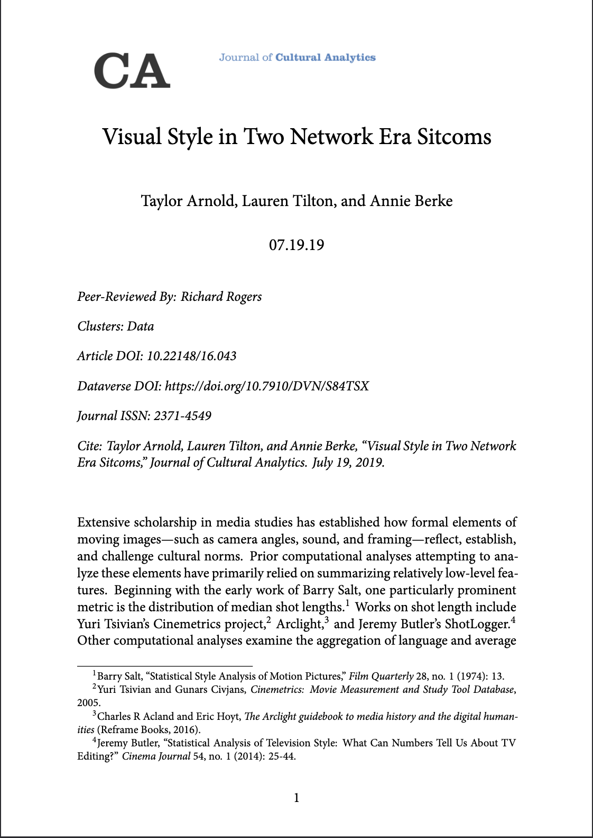
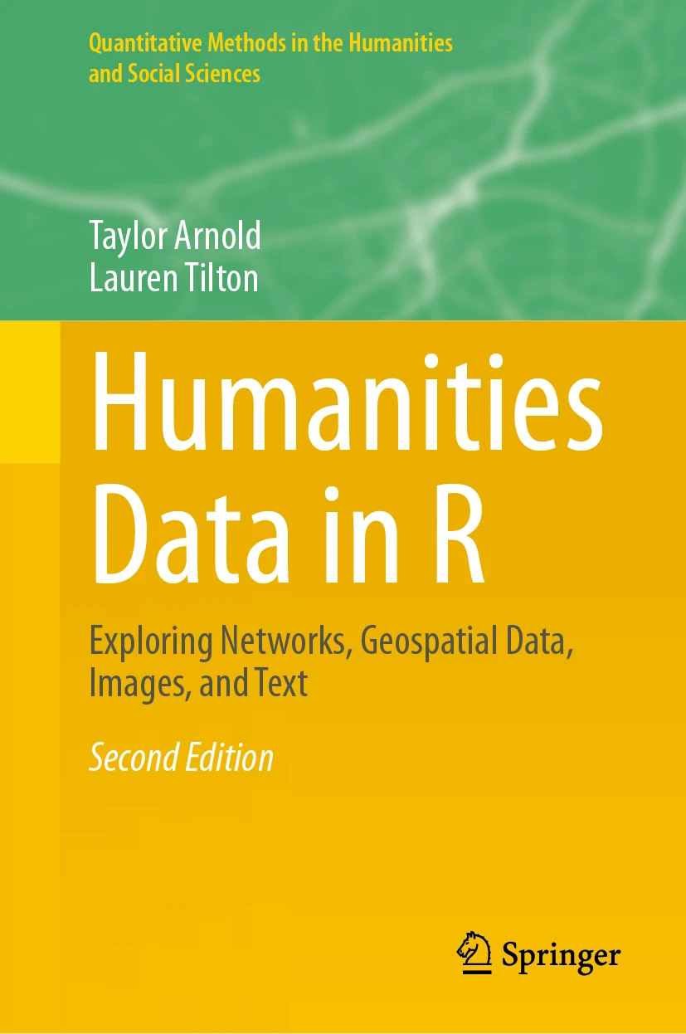
Approach 2: Supervised ML with Computer Vision
We have not integrated explicit tags using supervised machine learning algorithms into our public digital interfaces such as Photogrammar.
Our experience is that many algorithms, such as face detection and image segmentation, are too coarse to be of much use in a digital interface (every category would return thousands of images). In contrast, even object detection models with many categories still contain only a small subset of available object types.
However, these models are great for many other applications of distant viewing; the coarseness is a benefit when doing aggregative analyses. We make extensive use algorithms such as face detection in many research applications.
03 – Distant Viewing | Classic Approaches

Slide 19
Approach 3: Image Embedding
Image embedding algorithms associate an image with a sequence of numbers. The individual numbers have no direct meaning. Instead, the numbers have a relative connection to one another. Images that share common features will have similar sequences of numbers.
Image embeddings can be used to create recommendation systems for digital projects. These allow visitors to follow paths through an archive according to similar visual features.
We can also use embeddings to cluster the images and recommend different parts of the collection that may be of interest to different communities.
246, 170, 58, 175, 215, 117, 35, 63, 134, 218, 167, 126, 141, 236, 231, 165, 192, 177, 153, 44, 135, 196, 252, 28, 172, …..
03 – Distant Viewing | Classic Approaches

Slide 20

Approach 3: Image Embedding
Most image embedding algorithms are adapted from other computer vision models. For example, the diagram on the right shows the VGG19 model for detecting objects from 1000 different categories. This is a deep learning model that slowly changes each input image (left) into a sequence of probabilities (right).
A particularly interesting thing about deep learning models is that the interior steps tend to capture general features (e.g., texture, shape, and color) that go beyond the specific task at hand.
In particular, the numbers in the penultimate or antepenultimate step can typically be used as an image embedding.
T. Arnold and L. Tilton. (2021) "Depth in Deep Learning: Knowledgeable, Layered, and Impenetrable." In: Redrobe, K. and Scheible, J. (Eds.) Deep Mediations. University of Minnesota Press.
03 – Distant Viewing | Classic Approaches

Slide 21
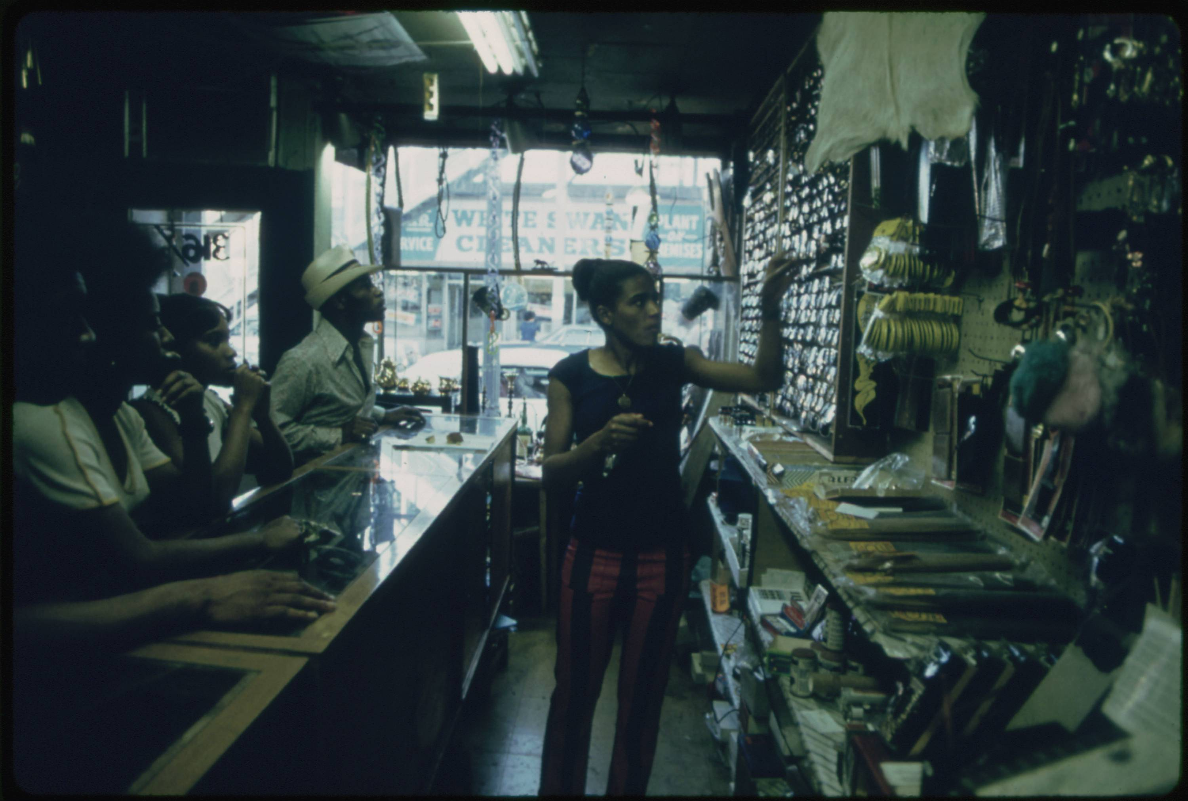
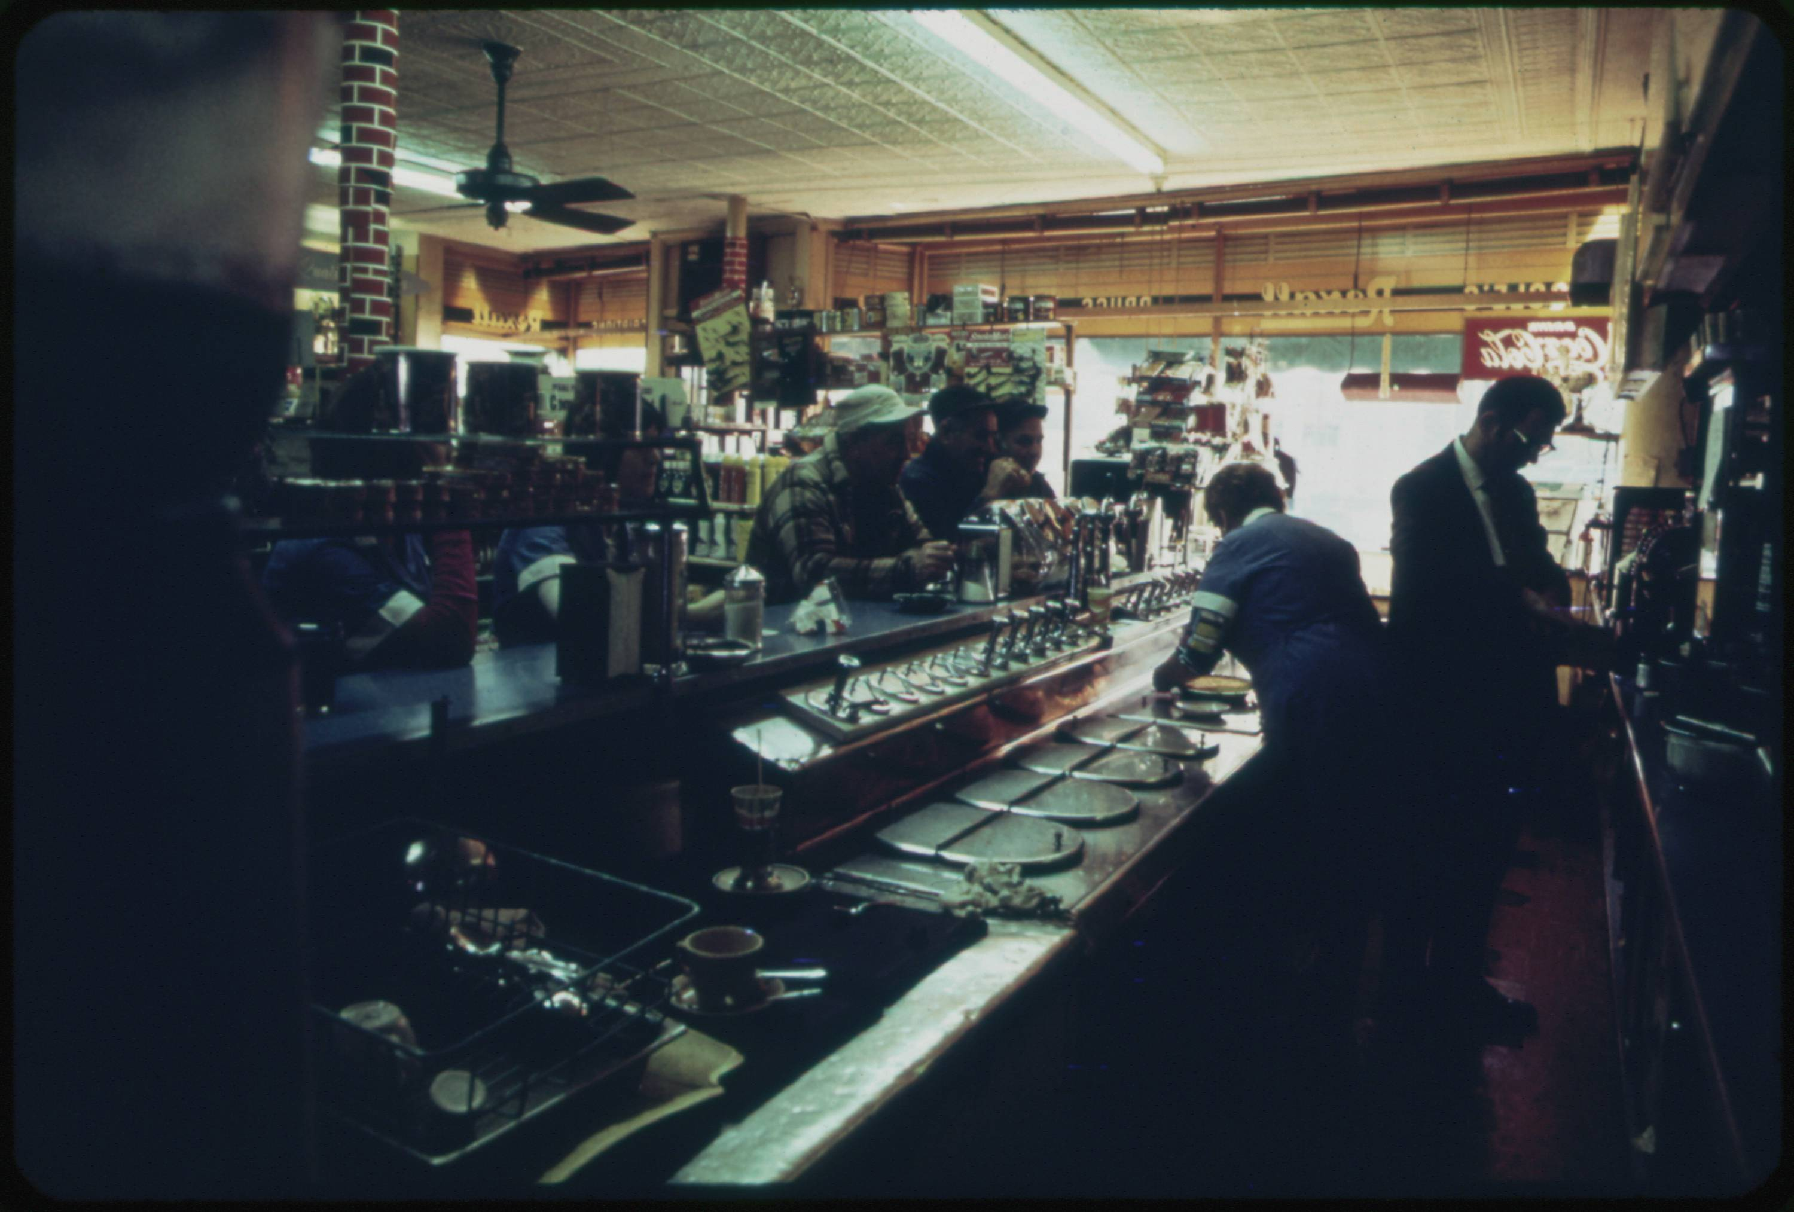
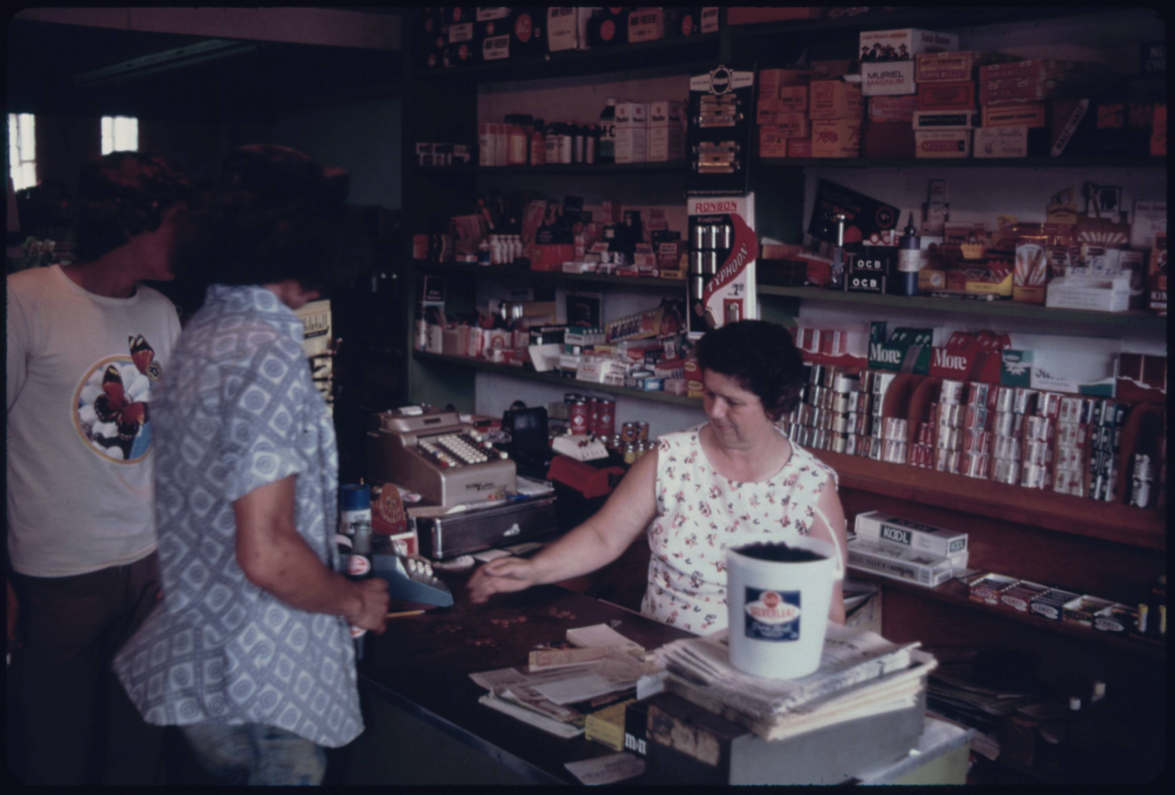
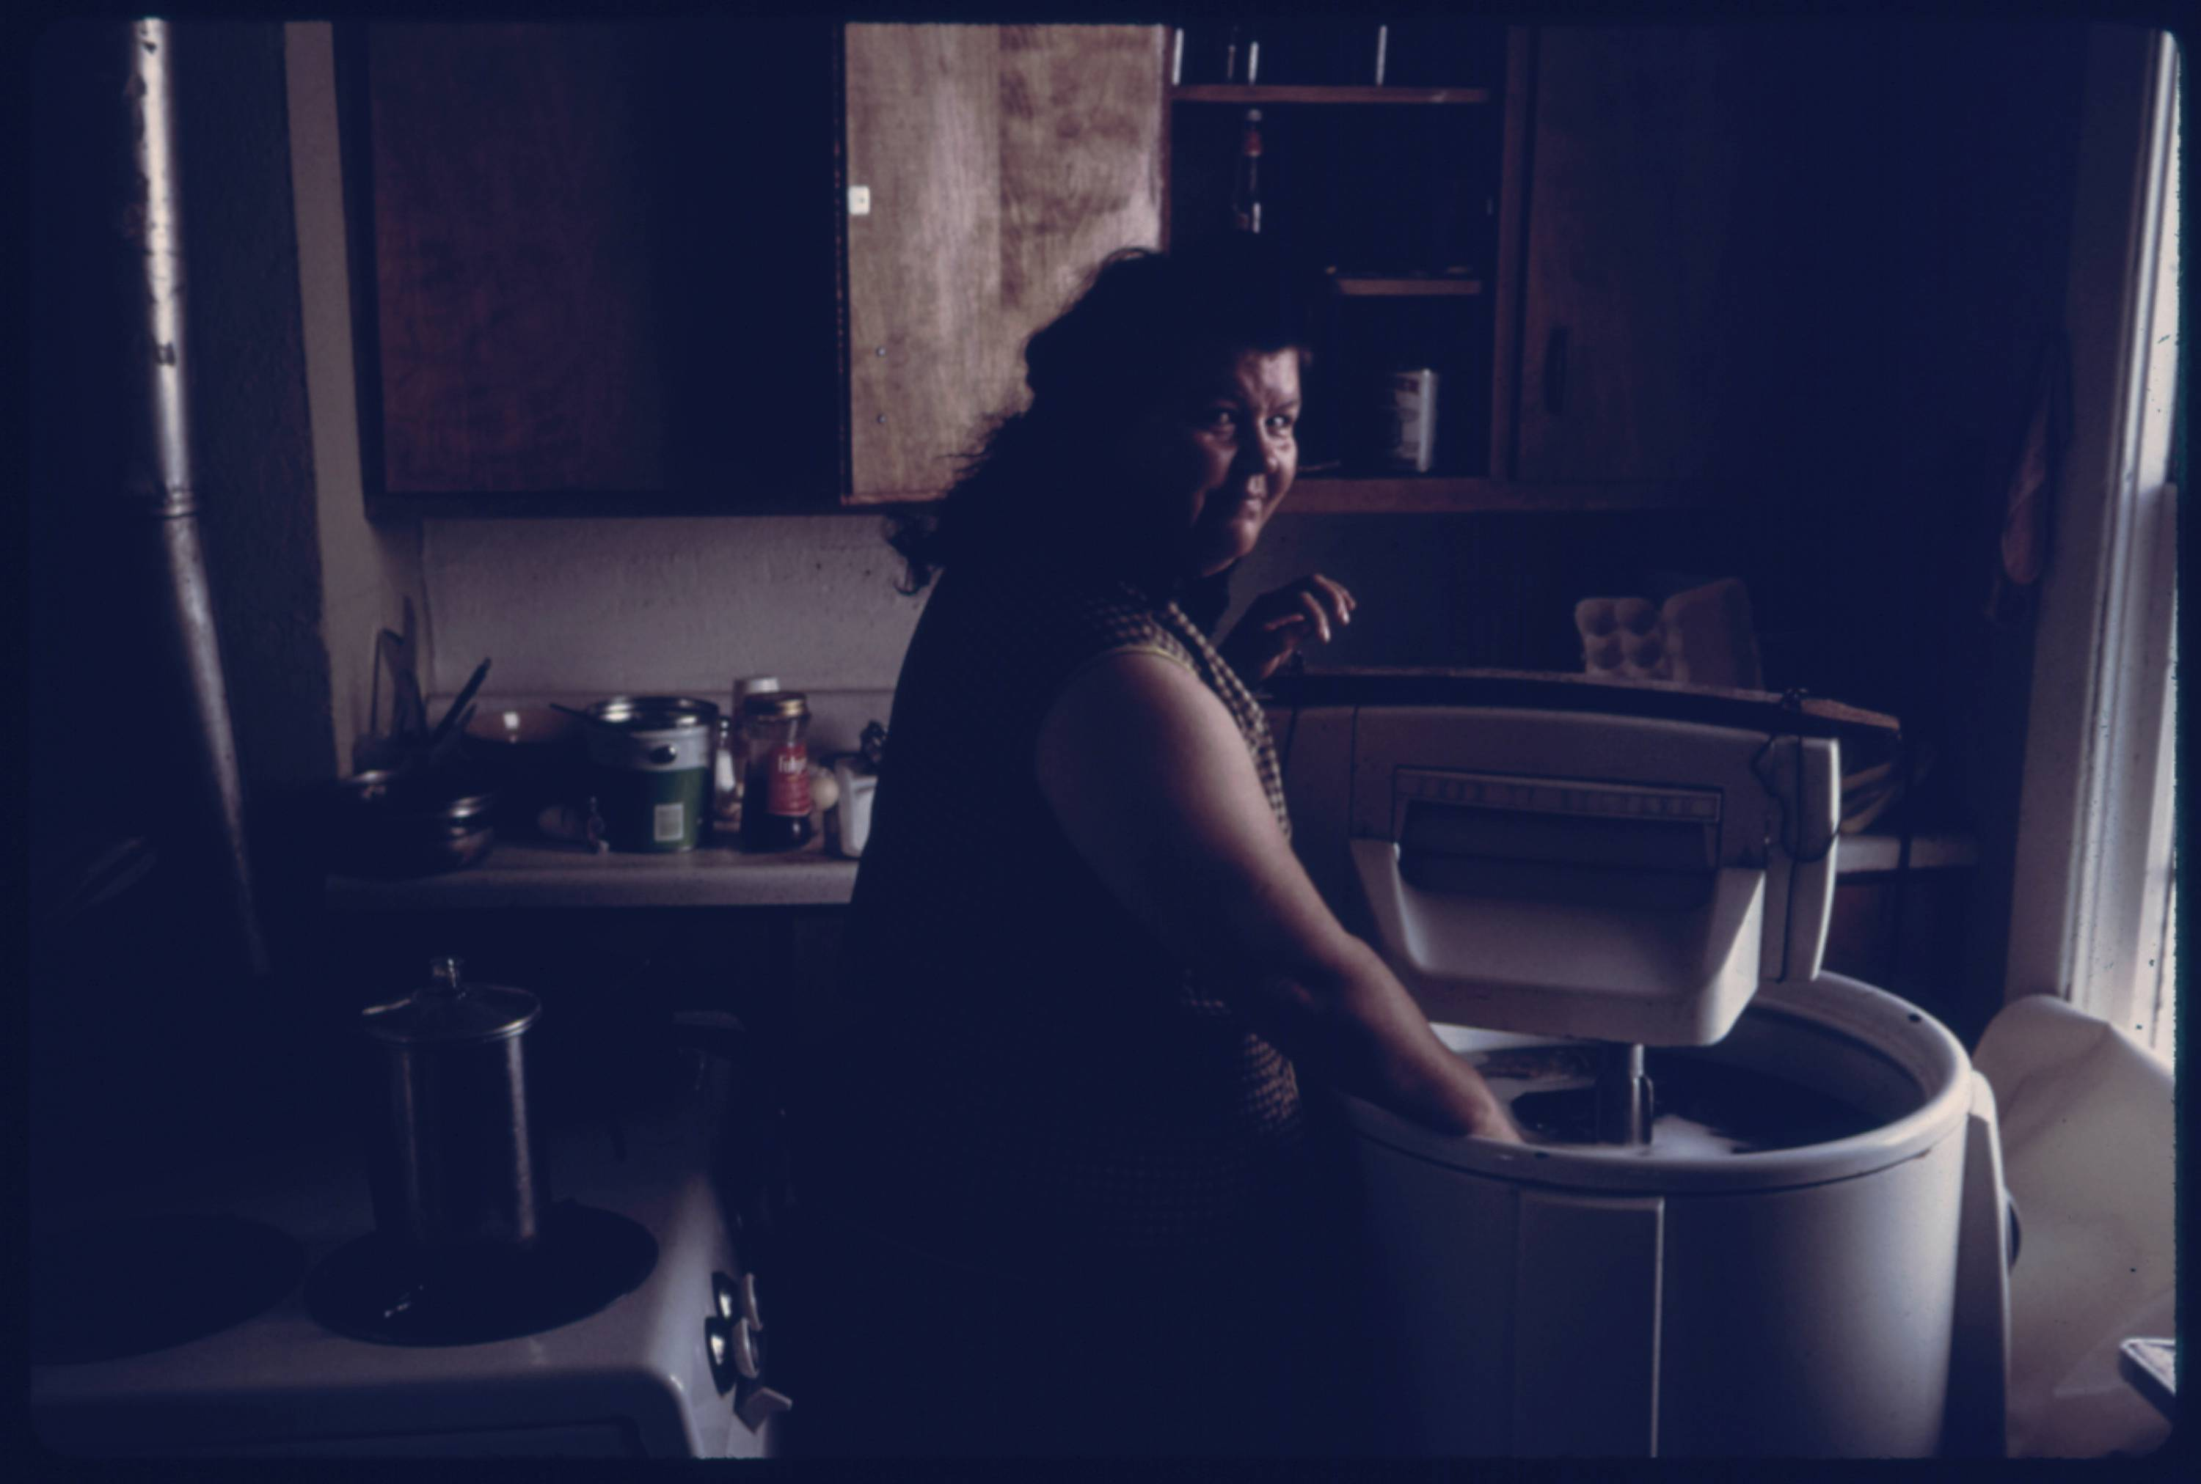
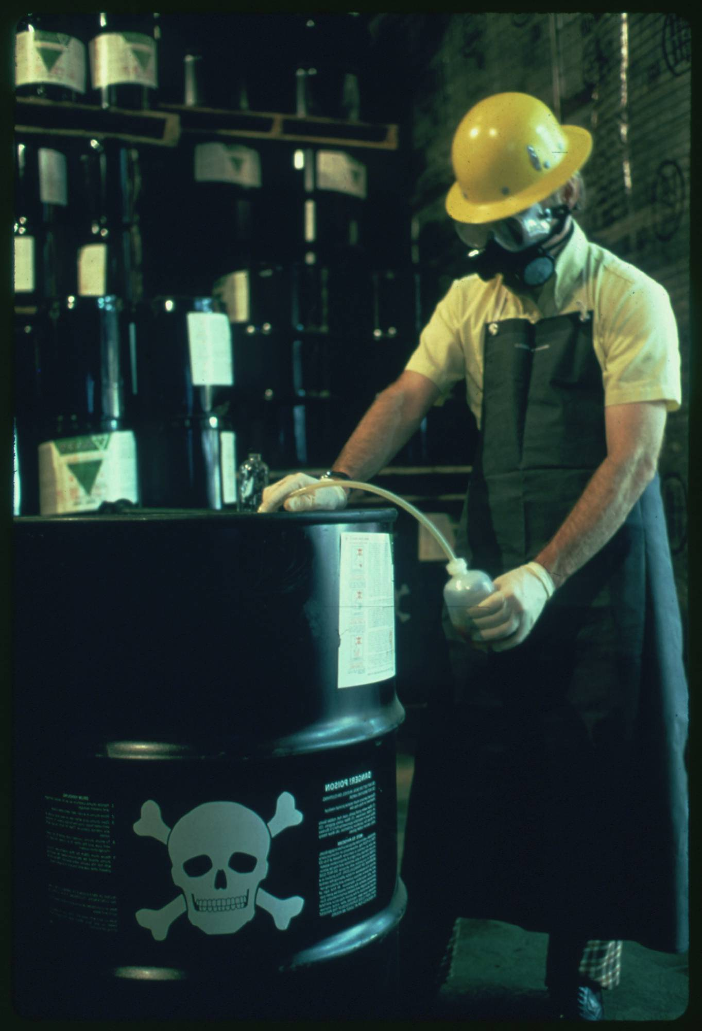
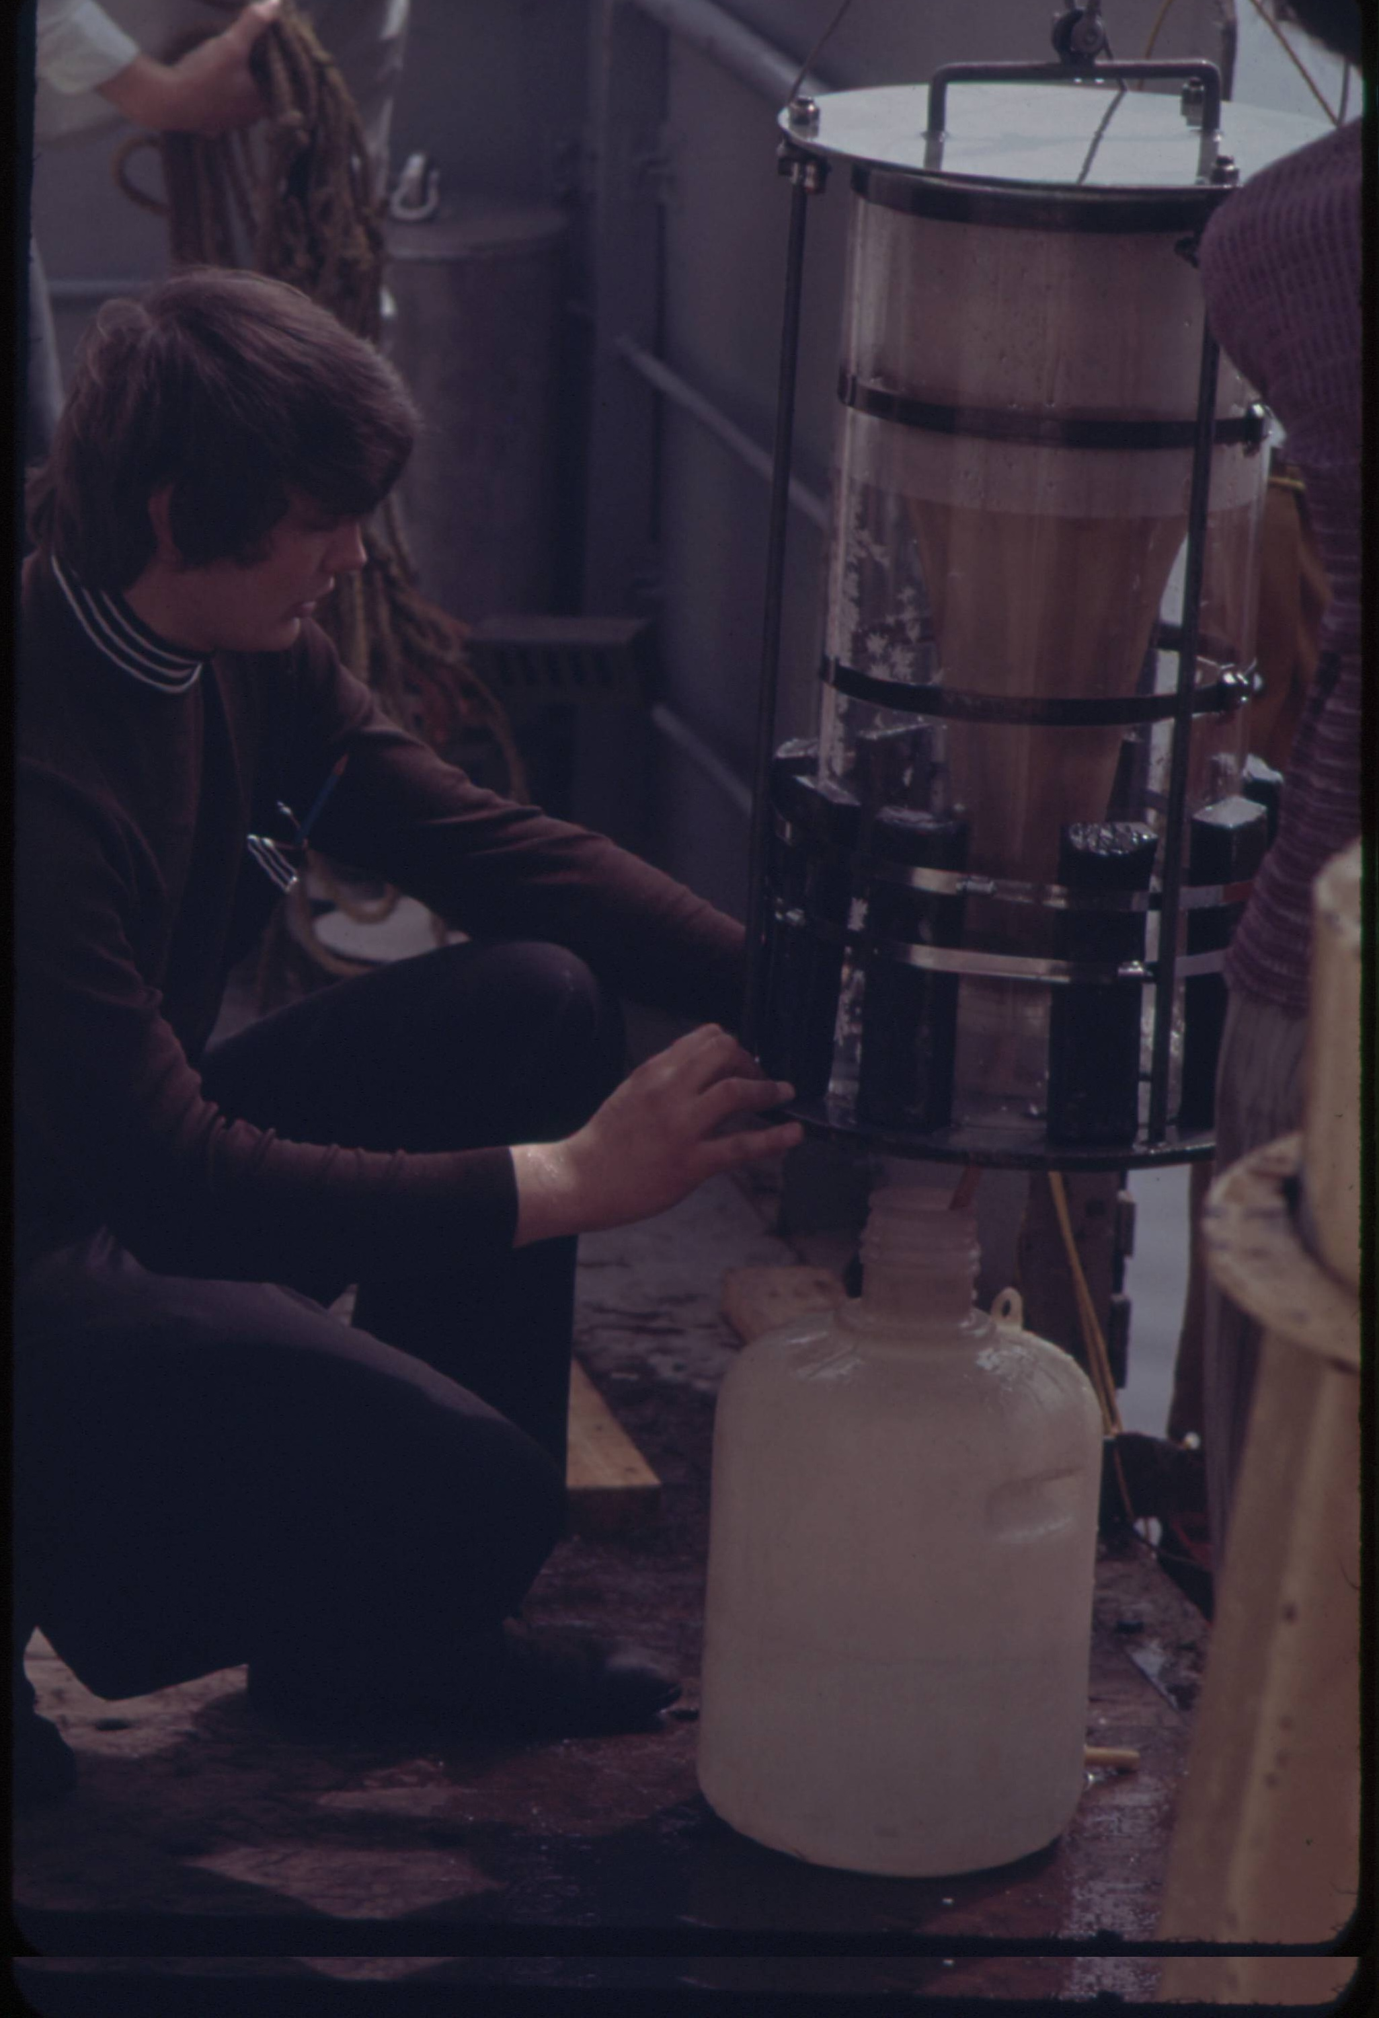
Approach 3: Image Embedding
Here are the six images that have the most similar set of embedding to our example image using the penultimate layer of the VGG19 model.
03 – Distant Viewing | Classic Approaches

Slide 22
Approach 3: Image Embedding
Advantages
Can be applied to any collection without need for existing archival metadata or a model specifically designed for a collection.
Adaptable across different collections.
Will cut across existing categories and find connections that have not been explicitly coded for.
Difficulties
No clear way to explain or control the connections and/or clusters.
Can create problematic or odd connections (for example, the link between milk production and radioactive waste).
Embeddings are usually made from object detection algorithms and have difficulty finding certain kinds of connections.
Can be influenced by the photo orientation and resolution.
03 – Distant Viewing | Classic Approaches

Slide 23
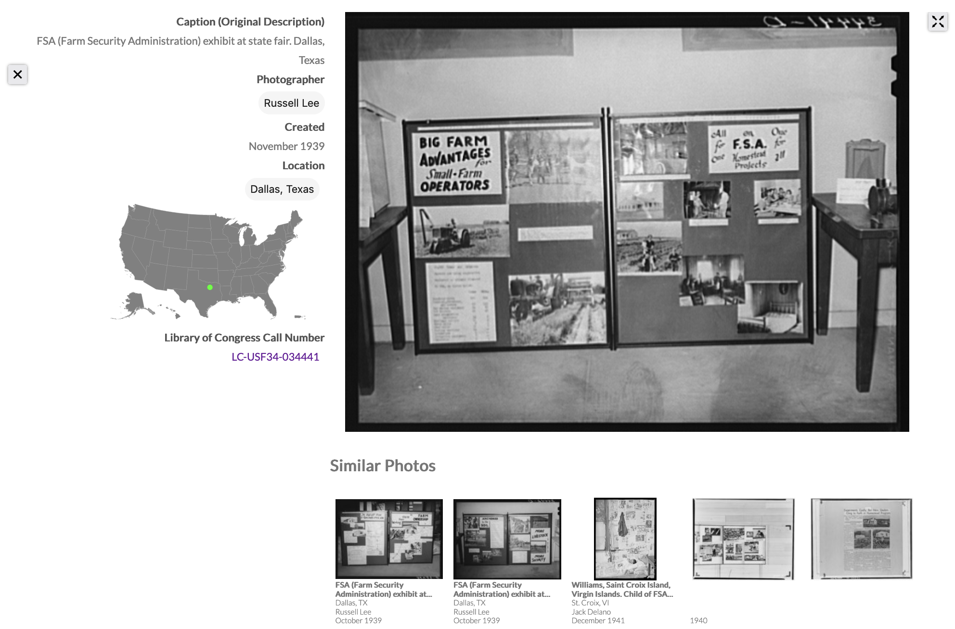
Approach 3: Image Embedding
We found image embeddings to be a great additional way of exploring the FSA-OWI photographs. The most recent major revision of Photogrammar (Version 3.0, 2021) includes visual recommendations for each of the photographs in the collection.
T. Arnold and L. Tilton. (2019) "Distant Viewing: Analyzing Large Visual Corpora." Digital Scholarship in the Humanities
03 – Distant Viewing | Classic Approaches

Slide 24
4. A New Approach with Multimodal Large Language Models (MLLMs)
04 – Distant Viewing | MLLMs

Slide 25




Multimodal Large Language Models (MLLMs)
Large language models (LLMs) have received a considerable amount of hype and press over the past two years. More recent model versions have included multimodal LLMs (MLLMs), which allow for combining text and image inputs and outputs.
Several MLLMs are currently available, including the most well-known efforts integrated into OpenAI’s ChatGPT, Google’s Gemini, and Anthropic’s Claude.
Several open models such as LLaVA (built on top of LLAMA-3) indicate that versions of MLLMs should be become/remain available for all users.
04 – Distant Viewing | MLLMs

Slide 26
MLLM Example (GPT-4 Turbo)
Let’s take our example image from the DOCUMERICA collection to understand some of the possibilities of these models.
We selected ChatGPT’s GPT-4 Turbo model as it was the generally considered the most powerful available at the time of our project (May 2024).
We provide the image along with a prompt suggesting the information that we would like the model to return.
Prompt: Provide a detailed plain-text description of the objects, activities, people, background and/or composition of this photograph.
04 – Distant Viewing | MLLMs

Slide 27
MLLM Example (GPT-4 Turbo)
Response: This photograph captures a scene inside an industrial or agricultural processing facility, possibly a dairy. The image focuses on a female worker engaged in operating machinery used for filling milk bottles. She is wearing glasses and a black top, and appears to be adjusting or handling the bottles or the machine. The worker is surrounded by a complex arrangement of stainless steel machinery and equipment. On the right side of the frame, there's a large metal vat or container, possibly holding milk or another liquid, with its lid partially visible. In the foreground, we see a series of white plastic milk bottles, each adorned with a red label. These bottles are lined up on a conveyor belt or a filling station, which seems to be part of a mechanized assembly line designed for packaging. The machinery includes various knobs, valves, metal structures, and hoses participating in the bottling process. The interior setting is lit with what appears to be fluorescent lighting, adding a utilitarian ambience to the workspace. The overall scene conveys a moment of daily operations wherein the worker is focused on ensuring the efficiency and correctness of the bottling process.
Prompt: Provide a detailed plain-text description of the objects, activities, people, background and/or composition of this photograph.
04 – Distant Viewing | MLLMs

Slide 28
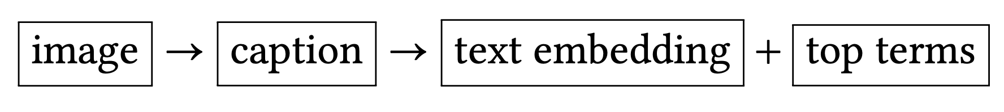
Using MLLMs For Search and Discovery
MLLMs provide a new approach to opening digital visual archives for increased search and discovery. We can create annotations by passing pairs of images and prompts together and storing the output.
The output can then by converted into text-based embeddings (created and used similarly to image embeddings) as well as top terms (using something such as TF-IDF and used like tags from archival metadata or supervised learning).
107, 230, 13, 85, 124, 65, 191, 221, 150, 6, 223, 242, 11, ….
text embedding
{ dairy, milk, glasses, machinery, worker, machinery }
image
top-terms
This photograph captures a scene inside an industrial dairy. The image focuses on a female worker engaged in operating machinery used for filling milk bottles….
caption
04 – Distant Viewing | MLLMs

Slide 29
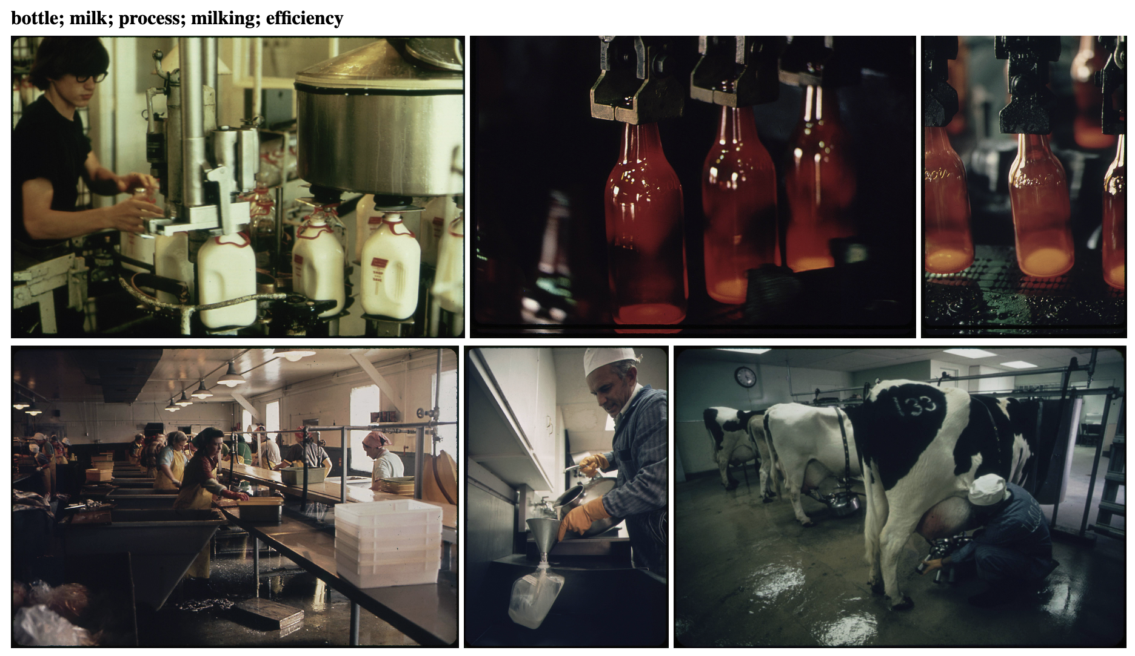
Using MLLMs For Search and Discovery
Here is our reference image along with the five images have the closest embedding based on the textual embedding of their automatically created captions.
Take note of the differences between the kinds of connections made here and those found in those using only image-based recommendations. The text recommendations find deeper semantic connections, such as the milking of cows and the bottling of milk, that would not come from the image-based approach.
04 – Distant Viewing | MLLMs

Slide 30
Using MLLMs For Search and Discovery
Here is our reference image along with the five images have the closest embedding based on the textual embedding of their automatically created captions.
Take note of the differences between the kinds of connections made here and those found in those using only image-based recommendations. The text recommendations find deeper semantic connections, such as the milking of cows and the bottling of milk, that would not come from the image-based approach.
We can even use the captions to determine a label for for the recommendations.
04 – Distant Viewing | MLLMs

Slide 31
Using MLLMs For Search and Discovery
Advantages
Can be used on any collection without the need for existing metadata.
The automatic captions can be used as both search and recommendation system.
Able to explain the connections between images.
Can filter/edit the text to try to avoid certain kinds of connections.
Can open the captions for inquiry or hide them to avoid exposing false-inferences.
Works on a variety of inputs, including art works and printed materials.
Continued Questions and Challenges
Questions about biases in the data (often not public).
Determining good prompts and models to use for specific applications.
Cost associated with non-public APIs or need to acquire large computing resources for public models.
04 – Distant Viewing | MLLMs

Slide 32
5. Digital Documerica
08 – Distant Viewing | Theory + MLLMs

Slide 33
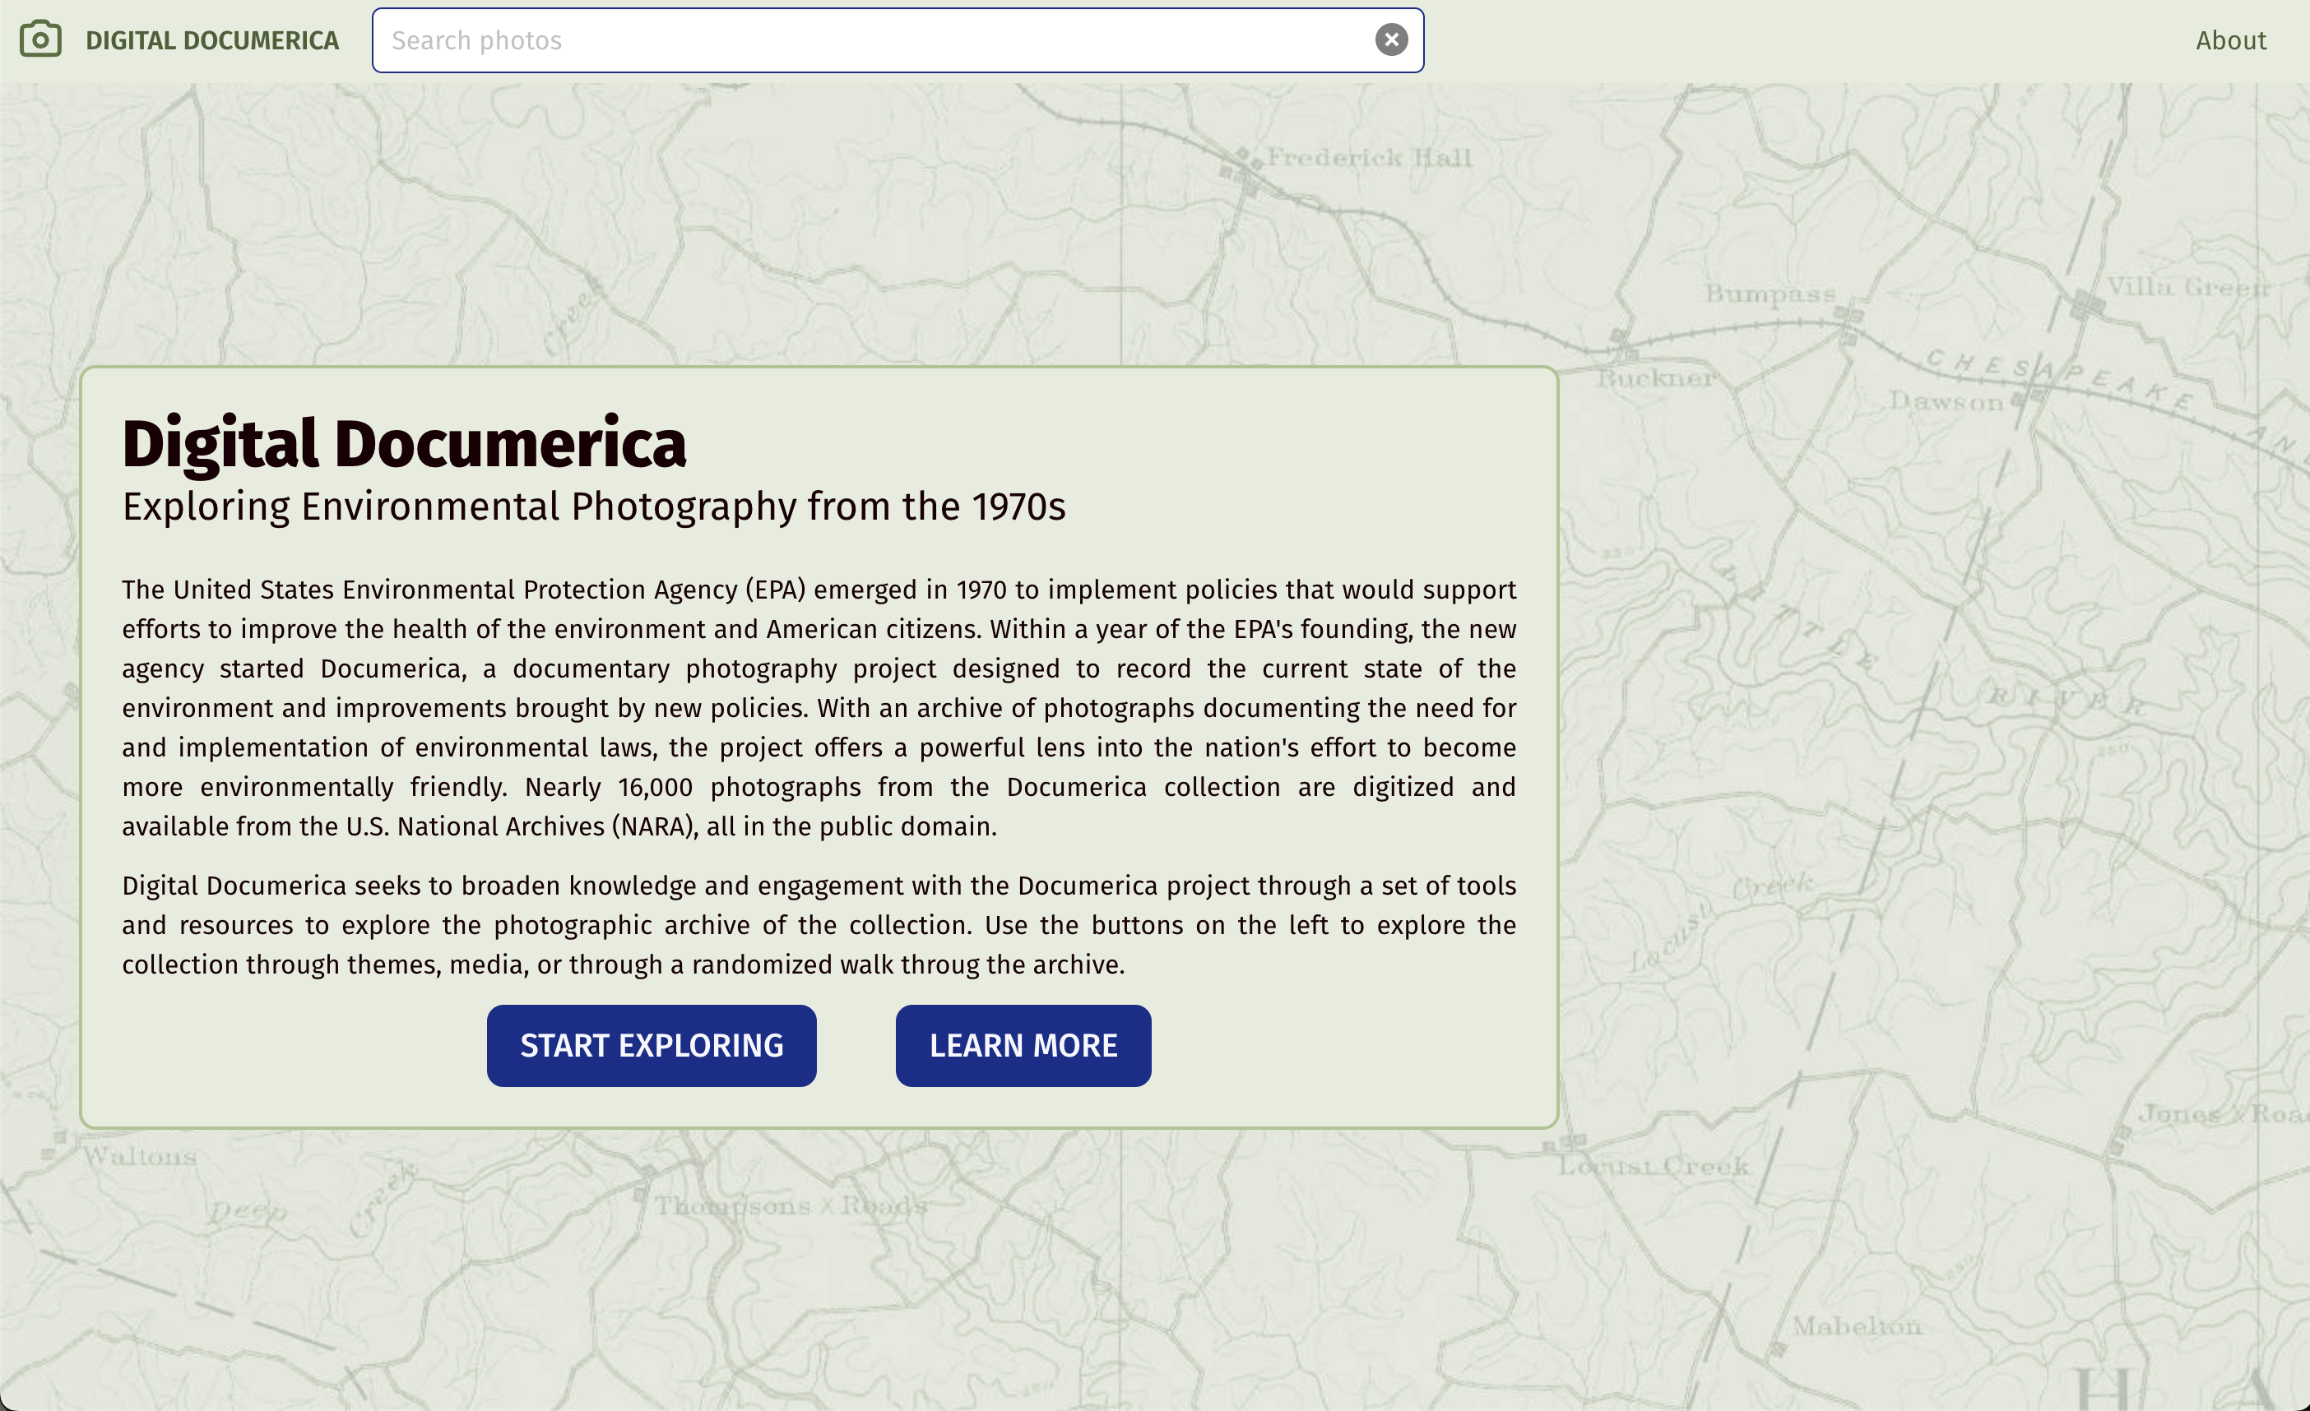
Digital Documerica
05 – Distant Viewing | Digital Documerica

Slide 34
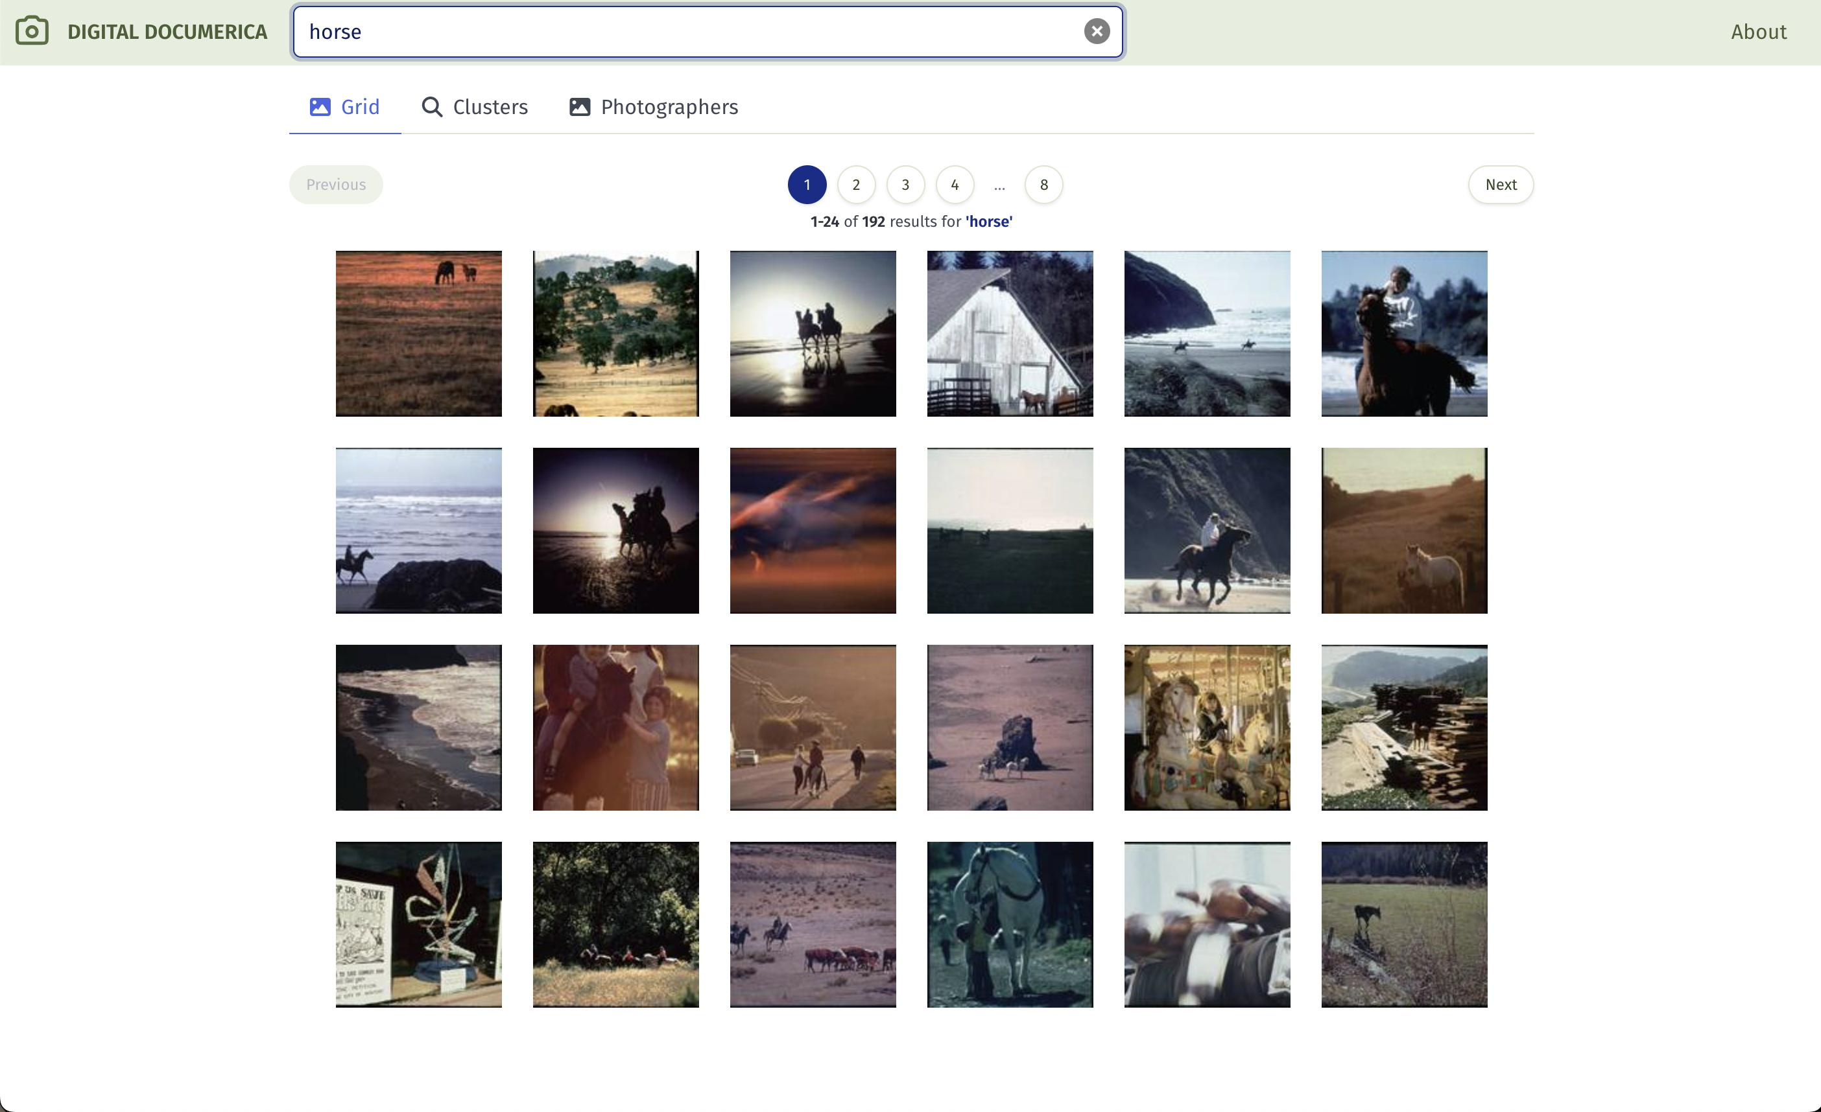
Digital Documerica
05 – Distant Viewing | Digital Documerica

Slide 35
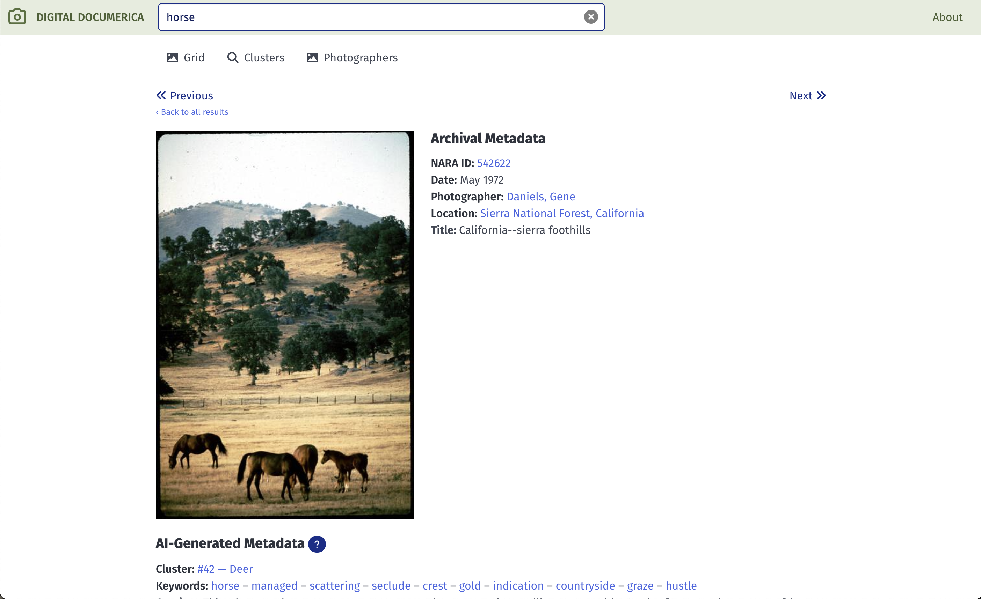
Digital Documerica
05 – Distant Viewing | Digital Documerica

Slide 36
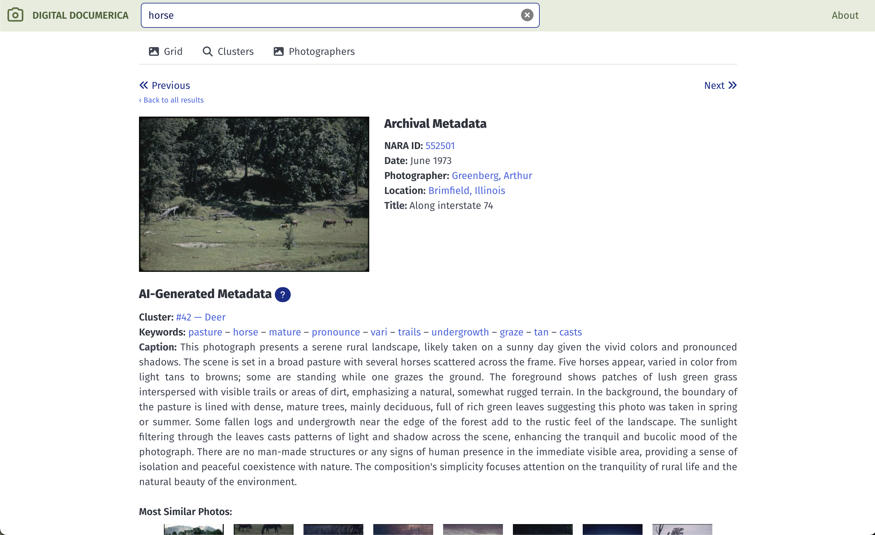
Digital Documerica
05 – Distant Viewing | Digital Documerica

Slide 37
6. Quantitative Evaluation
06 – Distant Viewing | Quantitative Evaluation

Slide 38
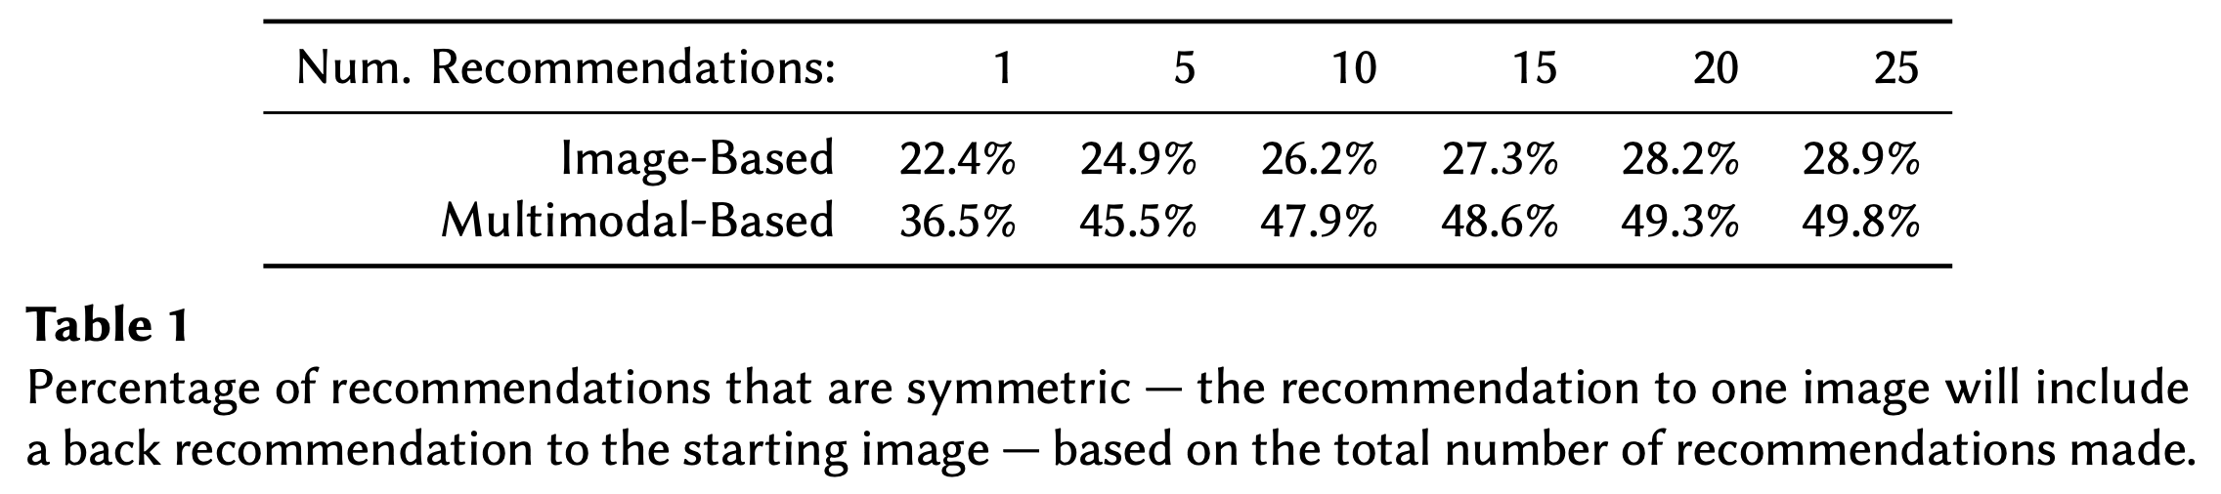
Symmetric Recommendations
In addition to the potential that we see from looking at a few example, it’s useful to also do some quantitative analysis of the results to compare the image-based and multimodal-based embeddings.
Here, we see the proportions of recommendations that are symmetric, seeing that the multimodal-based recommendations more consistently match in two dimensions. For 15-25 recommendations, the probability of having a symmetric link is about double that of the image-based method.
06 – Distant Viewing | Quantitative Evaluation

Slide 39
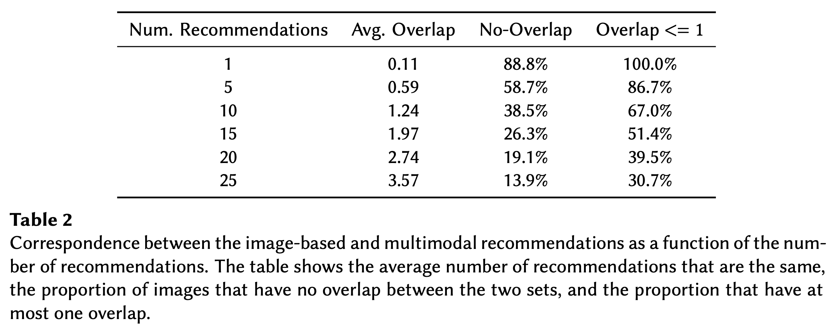
Comparing Image- and Multimodal-Embeddings
We can also see the overlap between the visual and multimodal recommendations. We would hope, and in fact see, that there is some overlap (good, because we know the visual recommendations do find interesting links) but that the multimodal approach mostly offers different links than those based on only images (indicating that this is an importantly different technique from previous methods).
06 – Distant Viewing | Quantitative Evaluation

Slide 40
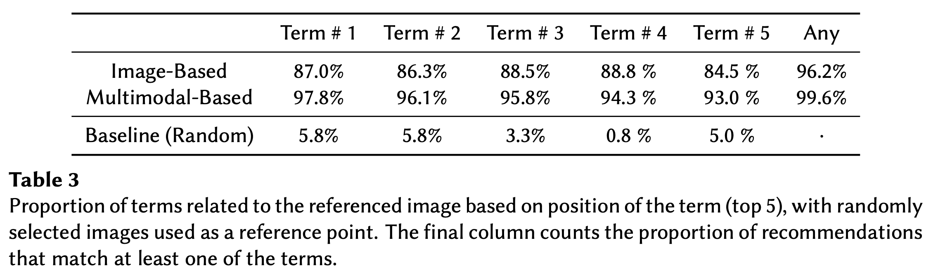
Explainable Recommendations
Finally, let’s see how much the tags associated with each of the sets of recommendations relates to the images. Here, we took a set of 100 recommendations and manually determined which links were valid.
We see that the the generated tags are useful for describing both image-based* and multimodal-based recommendations.
* The image-based tags use recommendations from the image embeddings but keywords from the multimodal model. These are not available with a visual-only approach.
06 – Distant Viewing | Quantitative Evaluation

Slide 41
THANK YOU!
Please get in touch!
distantviewing.org
tarnold2@richmond.edu
ltilton@richmond.edu

